Slide 1



AWS Solutions Architect
▷ Course Introduction - 3 Month
Skype: doanda86
Update: 09/2020

Slide 2
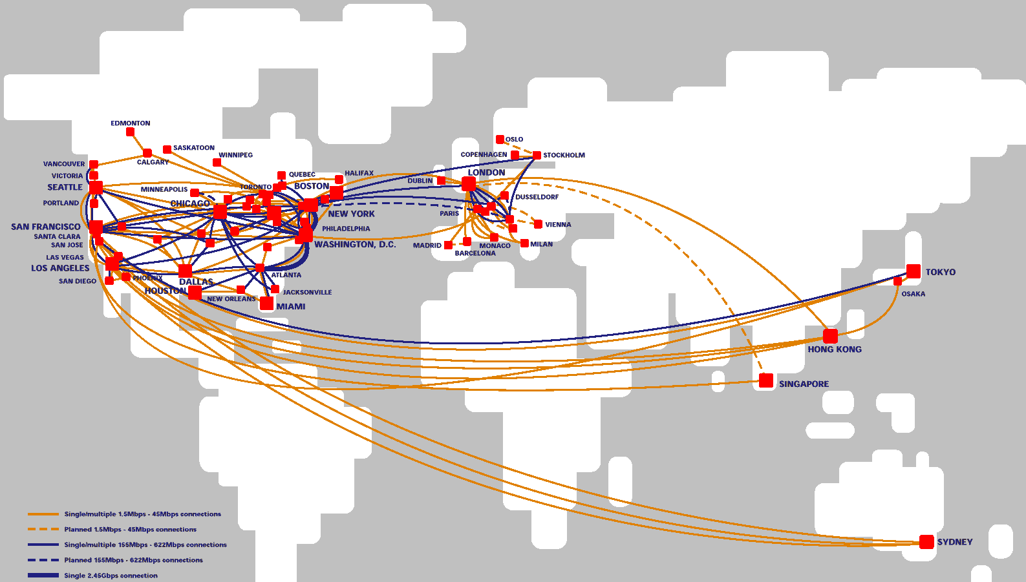
What is the Network?

Slide 3
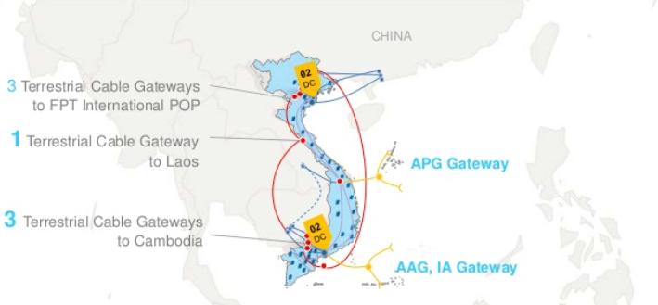
What is the Network?

Slide 4

Route?

Slide 5
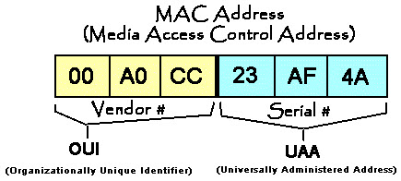

MAC Address

Slide 6
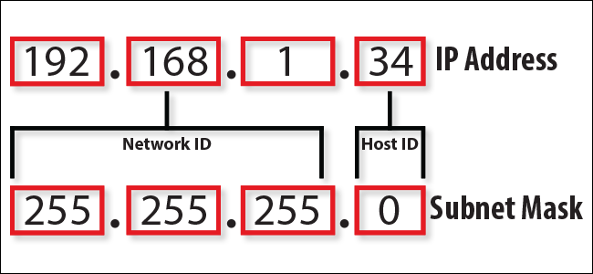
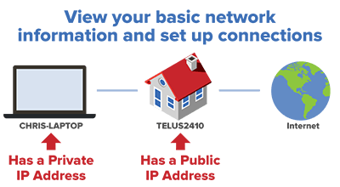
IP Address
IP_ADDRESS/SUBNET
● From 0.0.0.0 To 255.255.255.255

Slide 7
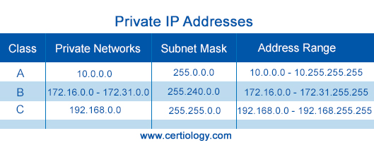
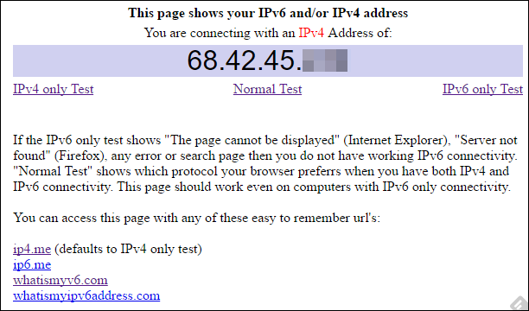
IP Address: Private & Public
● How to Find Your Private and Public IP Addresses

Slide 8
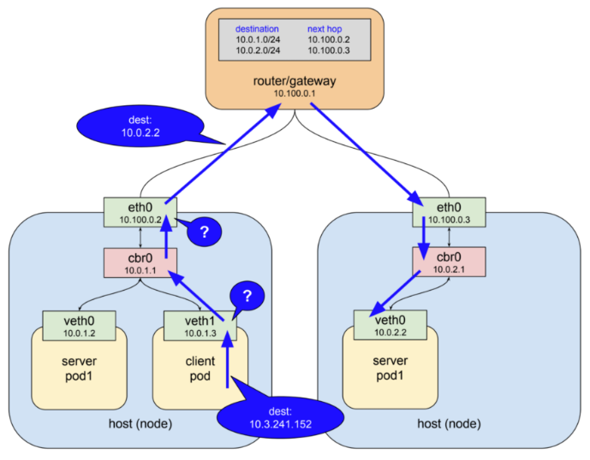
Source & Destination:

Slide 9
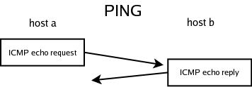
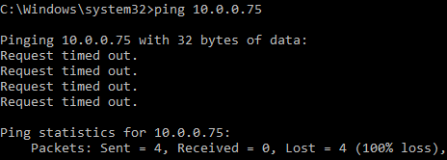
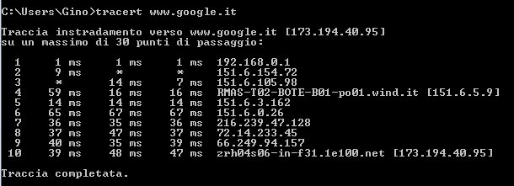
ICMP (Ping) & Traceroute

Slide 10
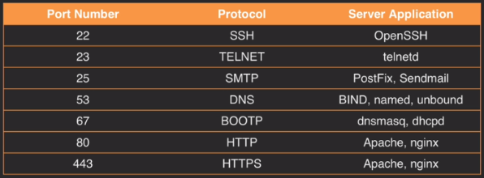
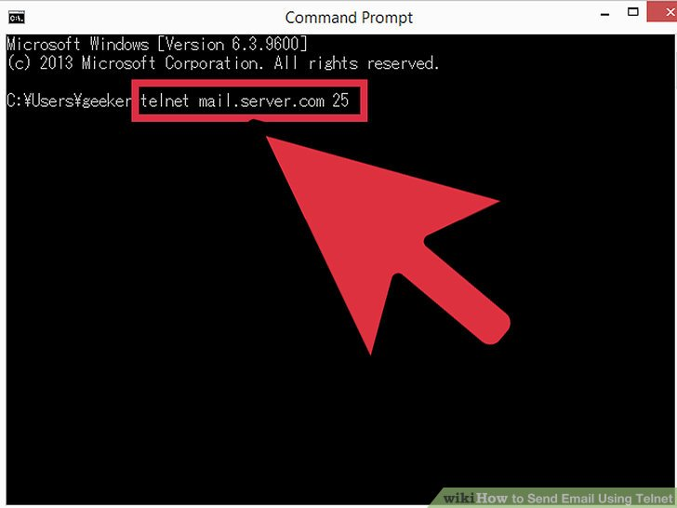
Port Protocol
● IP_ADDRESS:PORT_PROTOCOL
192.168.1.1:80
192.168.1.1:443
192.168.1.1:3306
● Telnet <IP_ADDRESS> <PORT PROTOCOL>

Slide 11
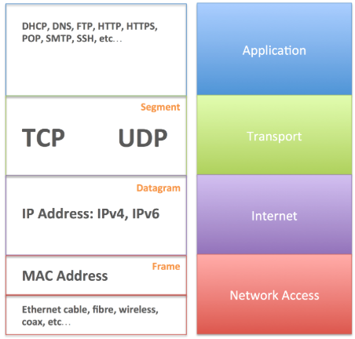
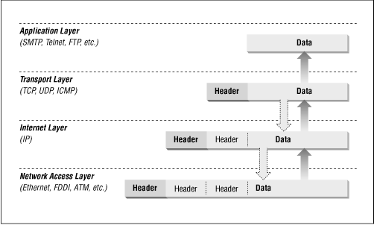
TCP/IP Model
● Step by Step: If Web_Server can not connect to Database_Server?

Slide 12
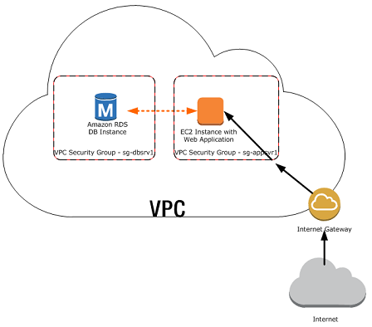
If Web_Server can not connect to Database_Server?
● Step 1: Status of Server.
(check bằng ping)
● Step 2: IP/ Domain có đúng không?
(check bằng nslookup)
● Step 3: Service (Web, MySQL) có chạy không.
(check bằng telnet)
● Step 4: Tình trạng CPU/ RAM của MySQL.
● Step 5: User/Pass của MySQL.
● Step 6: …….

Slide 13
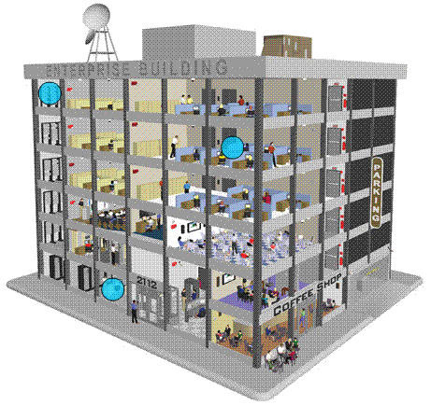
What is the LAN (Local Network)?
● How to Connect Head Office & Branch?

Slide 14
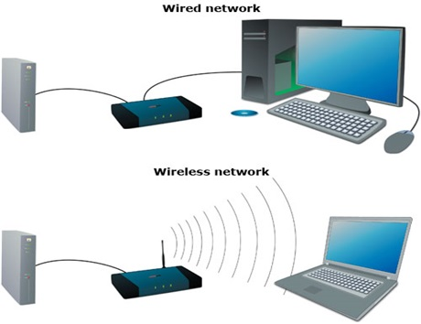
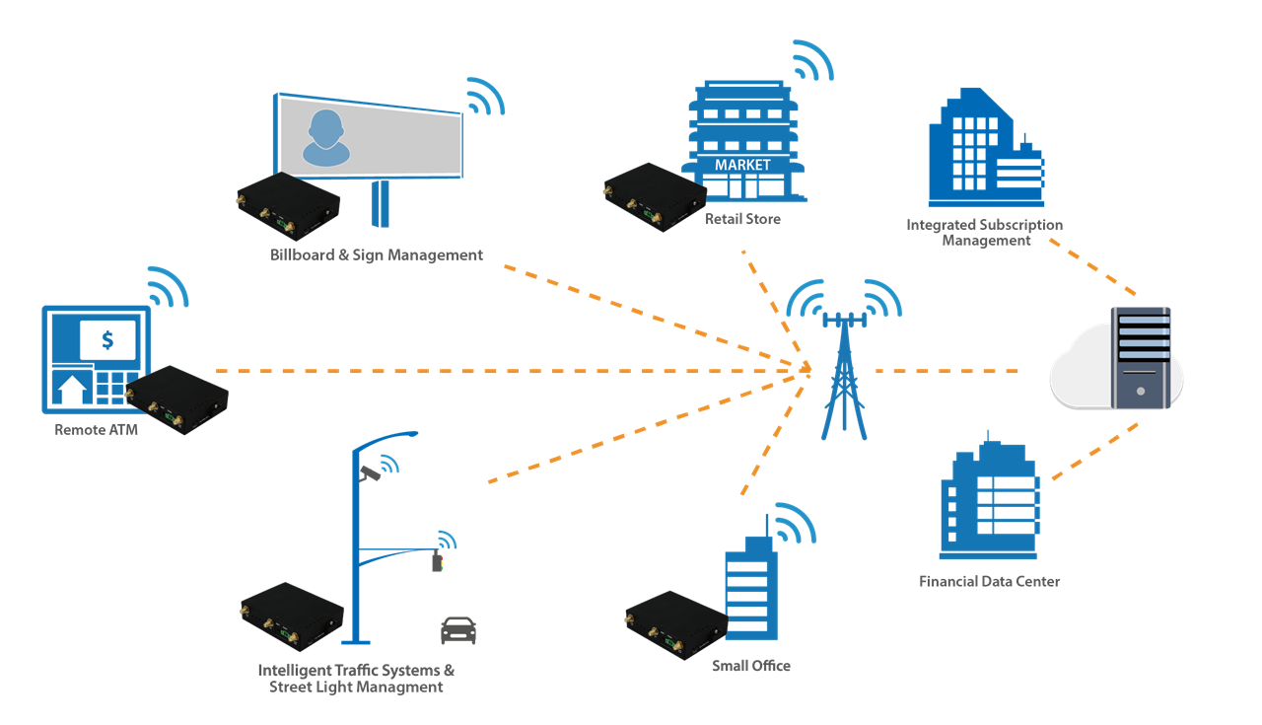
Wireless and Cable

Slide 15
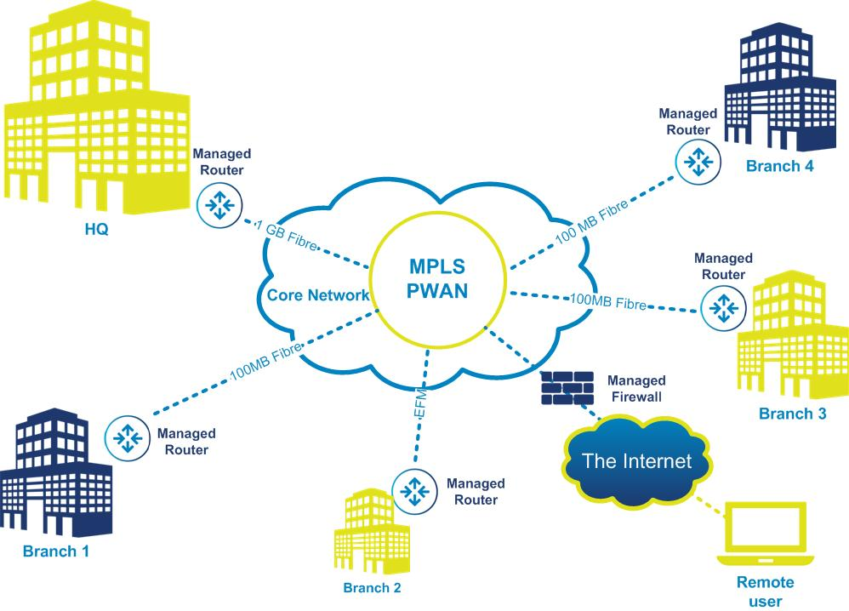
What is the WAN?
● Another solution?

Slide 16
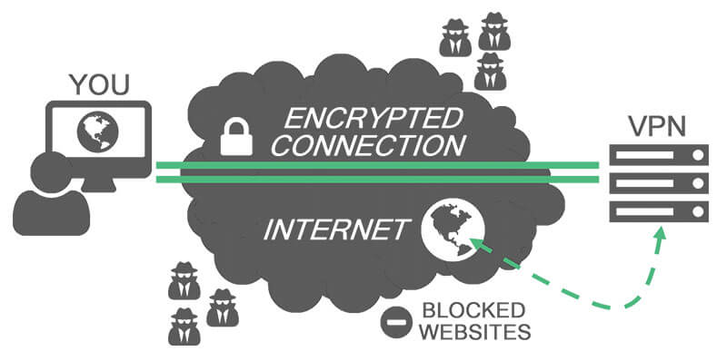
What is the VPN?

Slide 17
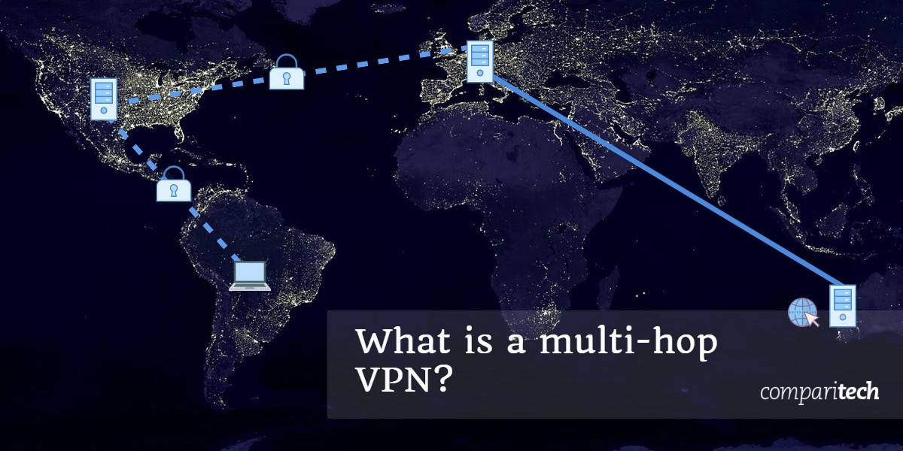
What is the VPN?

Slide 18
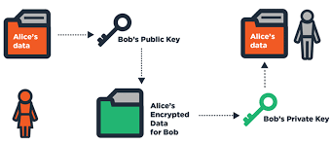
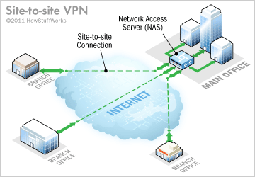
VPN: Site-to-Site

Slide 19
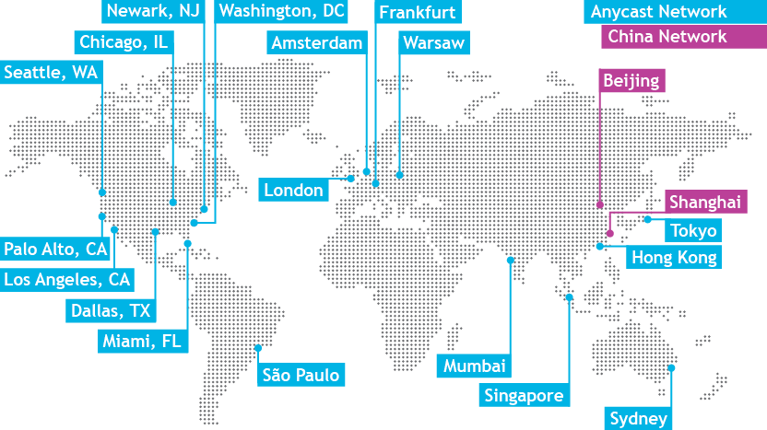
What is DNS?

Slide 20
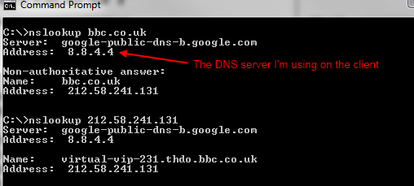
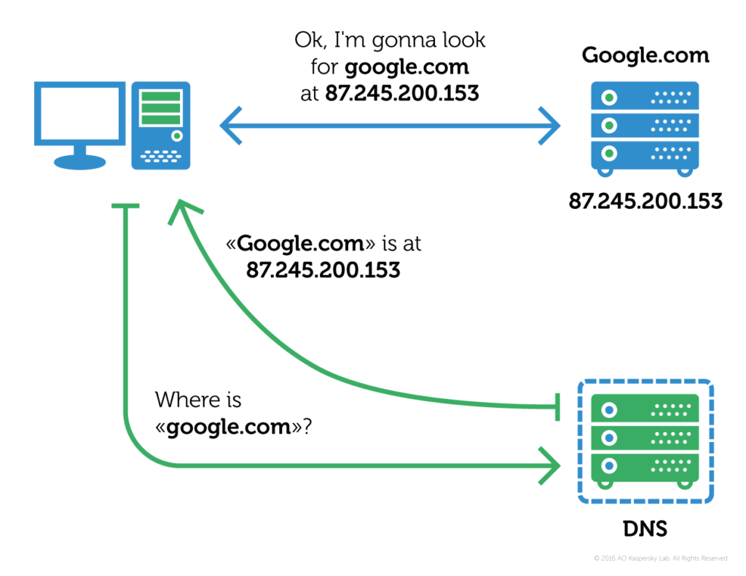
What is DNS?
● nslookup <DOMAIN NAME>

Slide 21

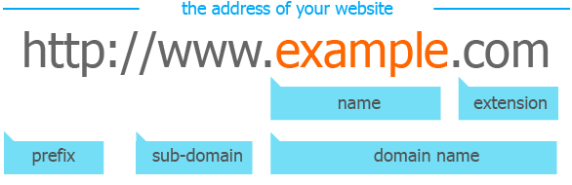
Domain name
● From IP Public to Domain

Slide 22
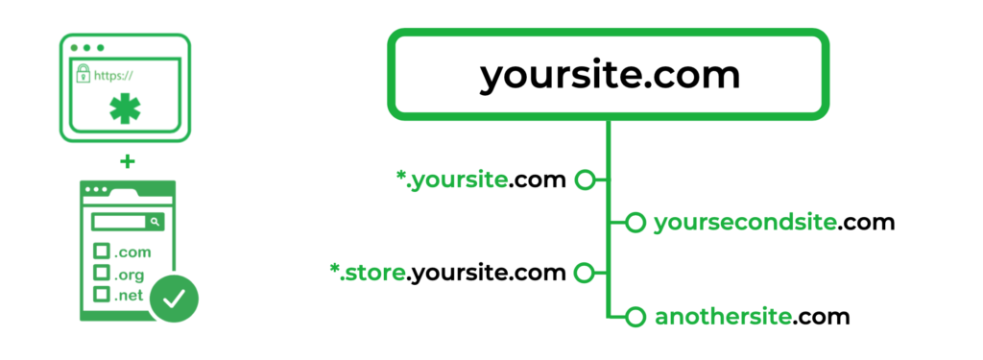
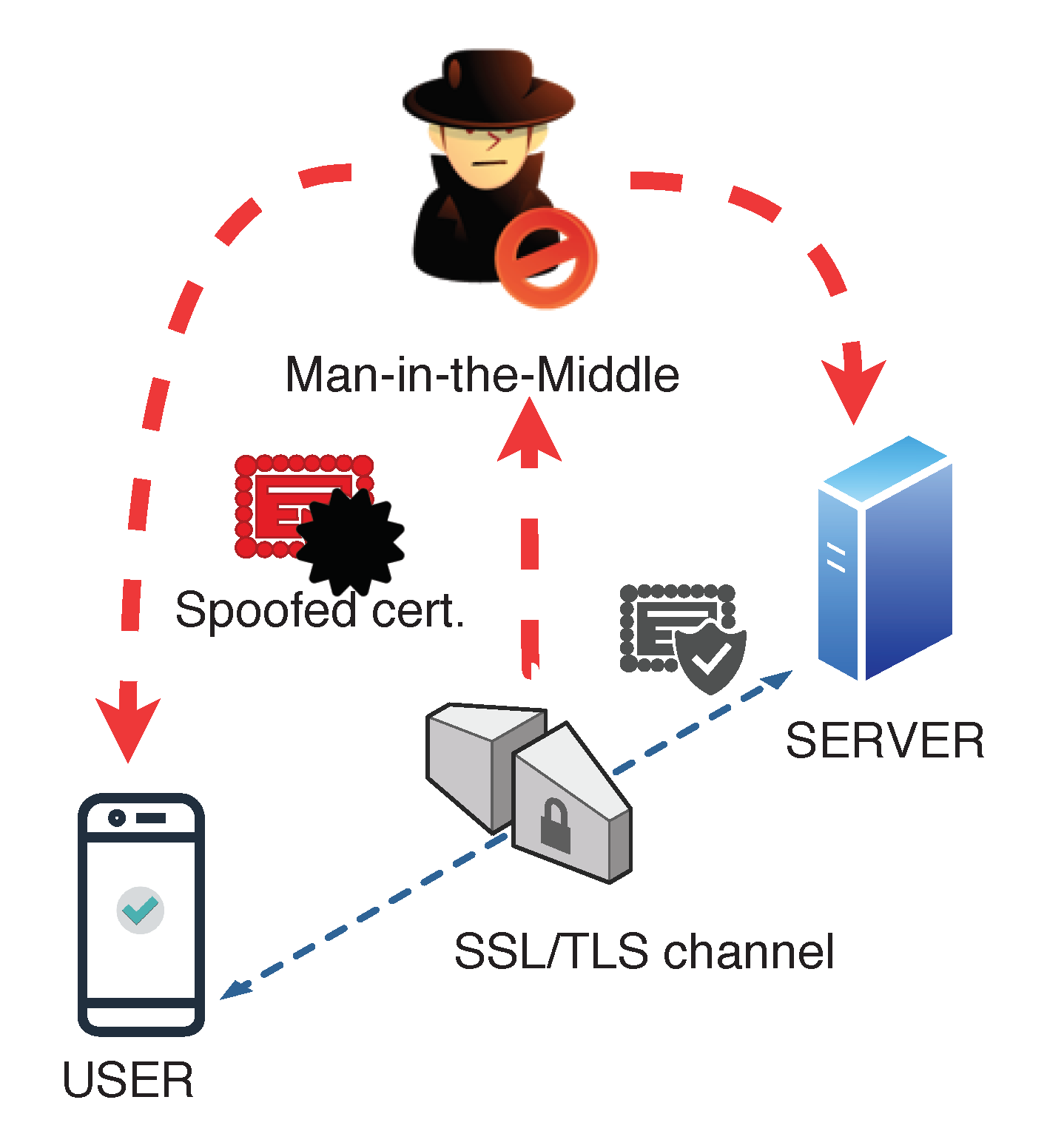
Domain name

Slide 23
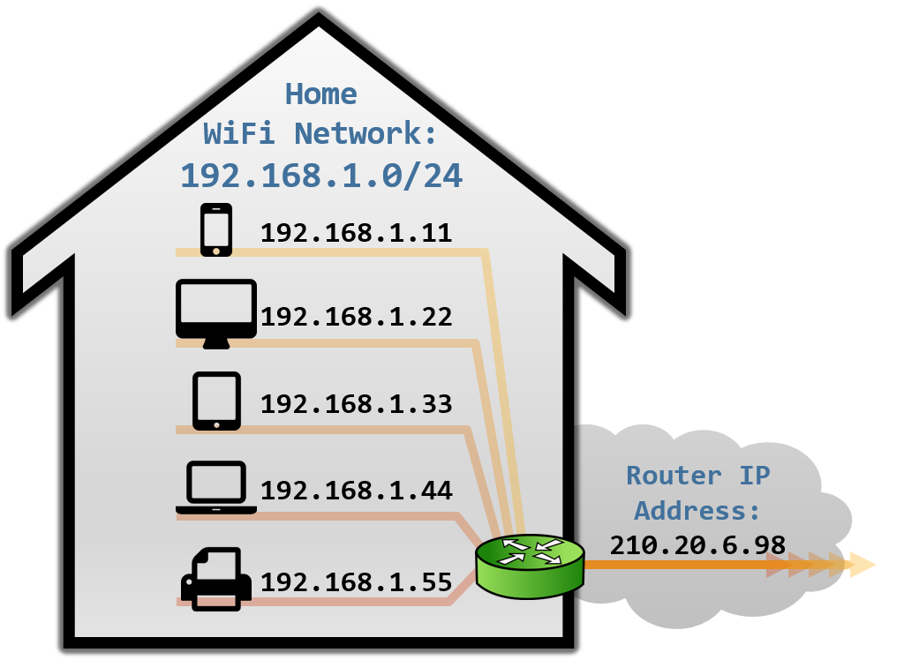
What is NAT?
● From Private to Public
● From Local to Internet

Slide 24
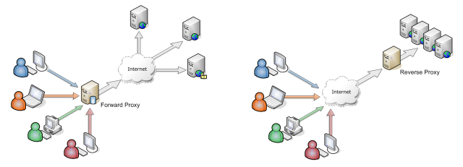
Forward Proxy & Reserve Proxy
● The main difference between the two is that forward proxy is used by the client such as a web browser whereas reverse proxy is used by the server such as a web server.

Slide 25
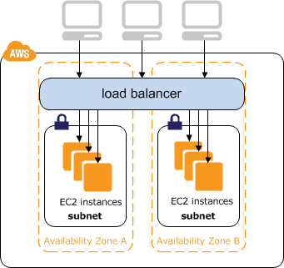
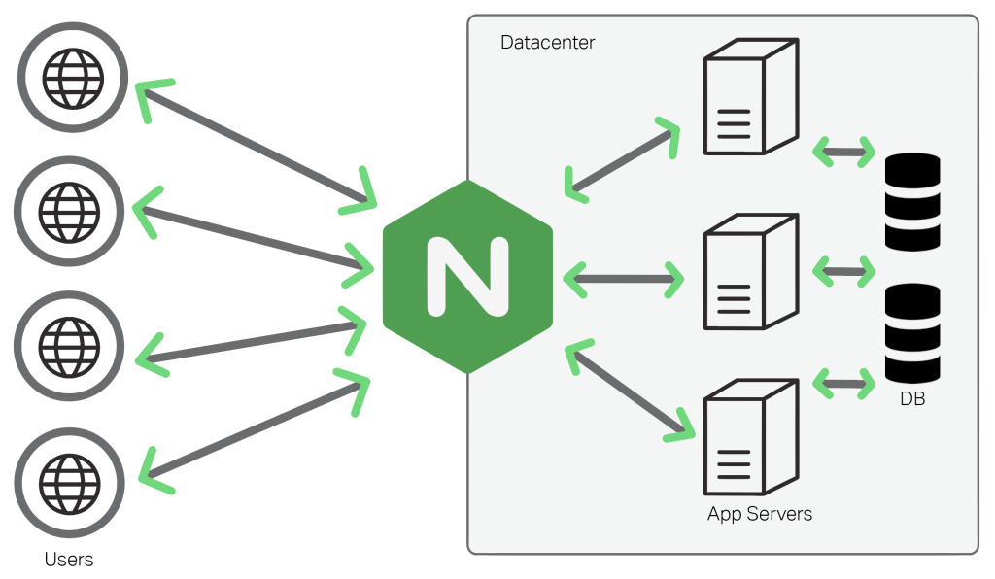
Reverse Proxy & Load Balancer

Slide 26
Session: Some basic concept ...
● Startup
● Global Infrastructure
● What is the AWS ?

Slide 27
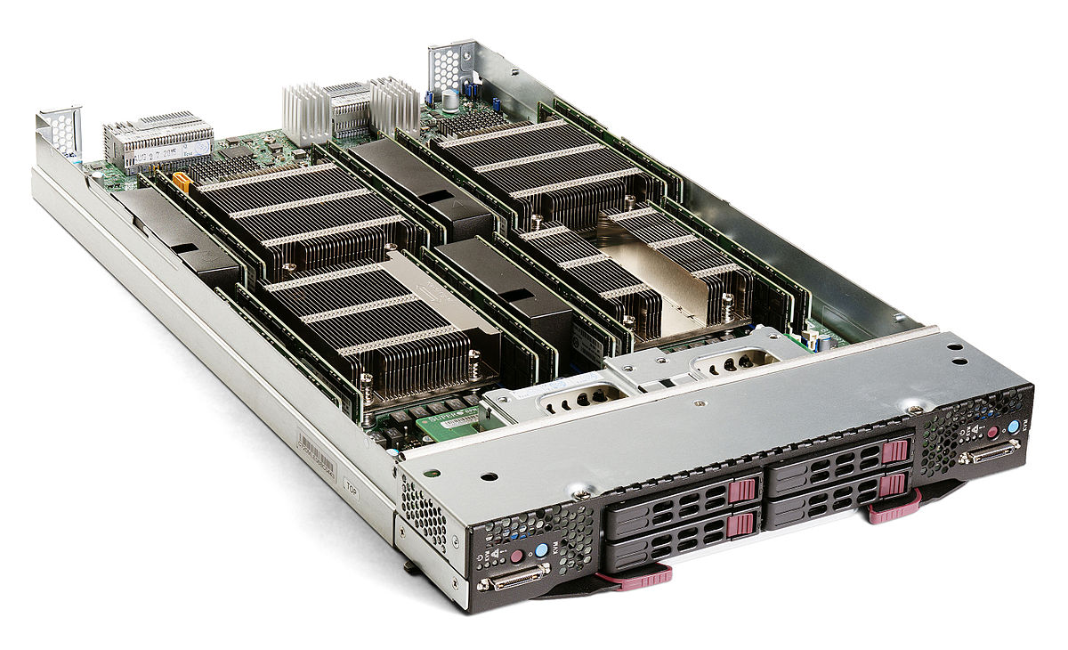
Physical Server

Slide 28
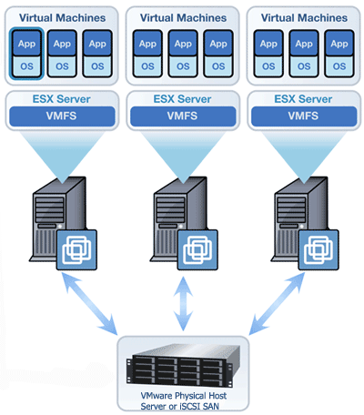
Virtual Machine

Slide 29

Data Center

Slide 30
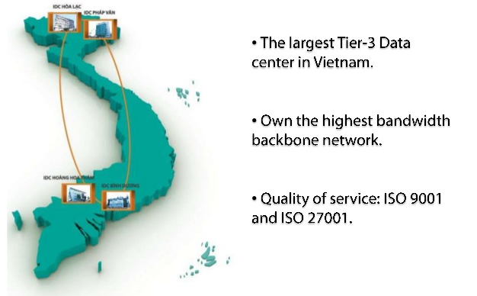
Data Center: Multi-Site

Slide 31
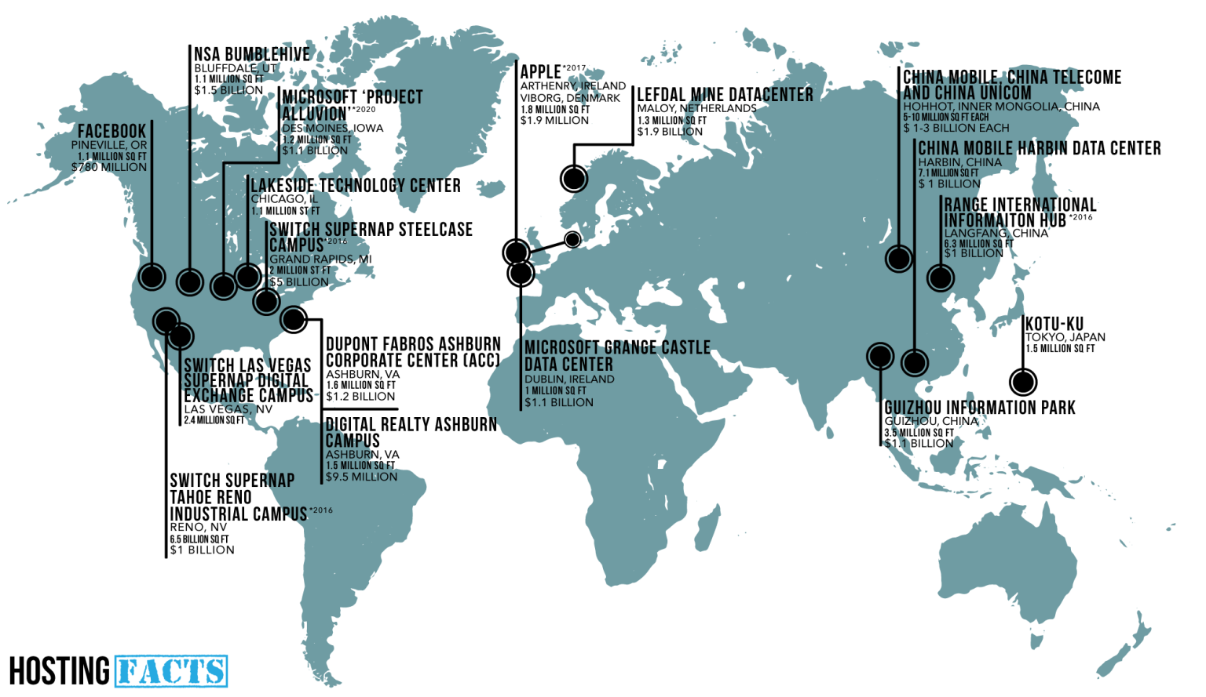
Data Center: Global

Slide 32

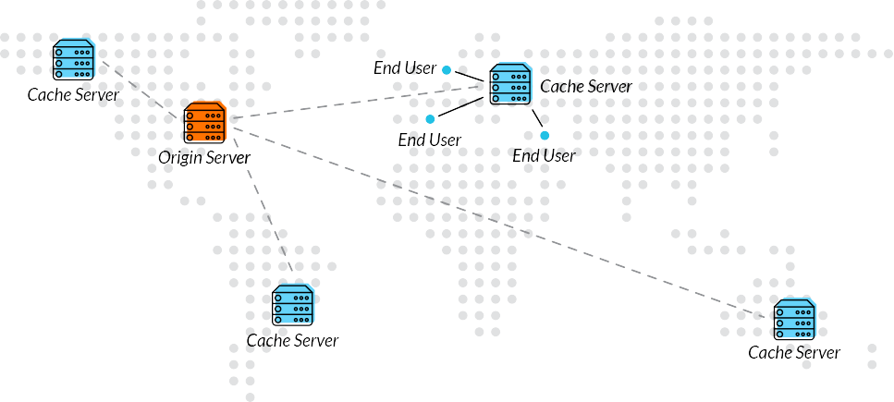
CDN: Content Delivery Network

Slide 33

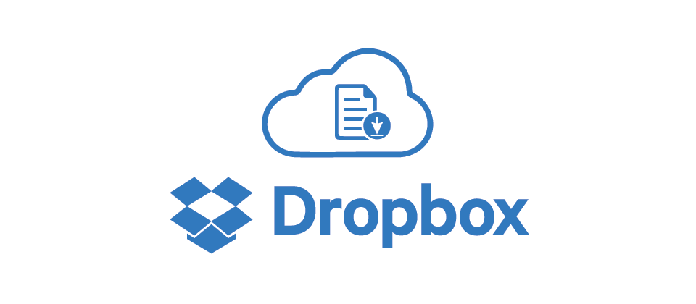
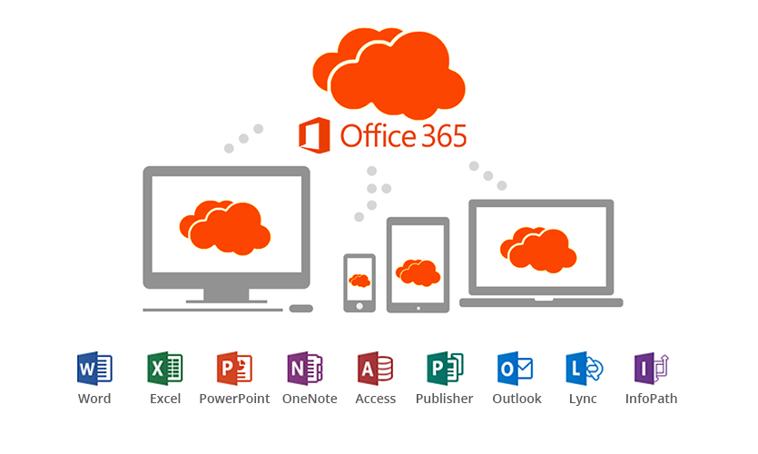

Cloud Computing

Slide 34

Six Advantages of Cloud Computing
● Cost - Pay only for what you use
● Scale
● Capacity
● Speed and agility
● Stop spending money running and maintaining data centers
● Go global in minutes

Slide 35
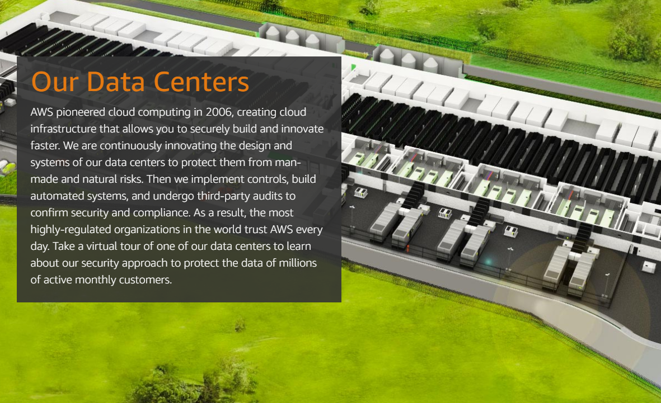
● https://aws.amazon.com/compliance/data-center/

Slide 36
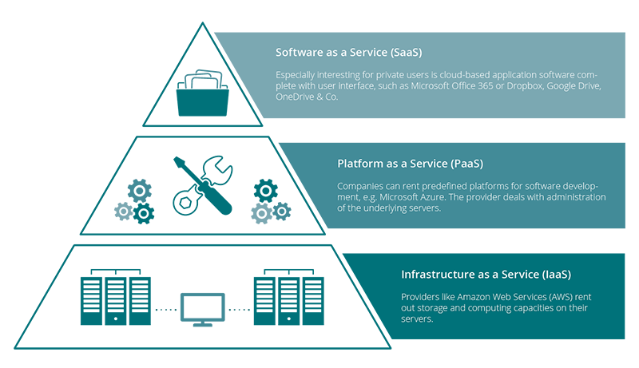
Cloud Computing Models
● IaaS
● PasS
● SaaS

Slide 37
Session 1: Server-Based Computer Service
● EC2
● EFS
● VPC

Slide 38
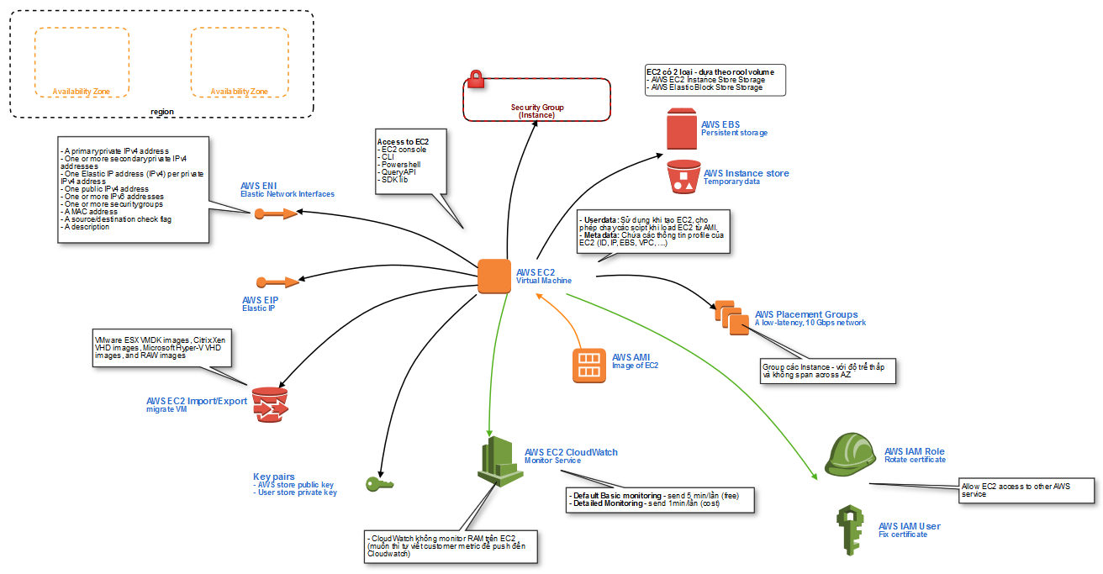
AWS EC2 (Elastic Compute Cloud)

Slide 39
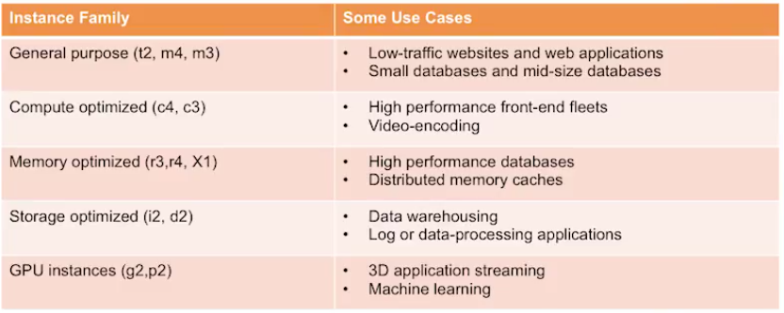
Choosing the EC2 Instance
T - Test/dev: Small workloads, ...
M - Main: Data processing tasks, backend, ...
C - CPU: Analytics, science app, game
R: RAM: Memory, Caching
I - I/O: NoSQL, Hadoop, …
G2 - GPU

Slide 40
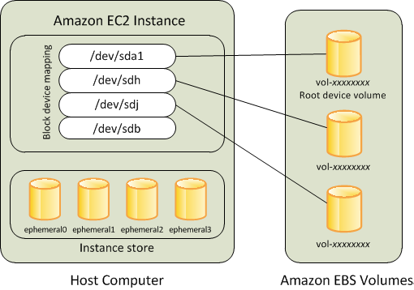
AWS EBS & Instance Store

Slide 41
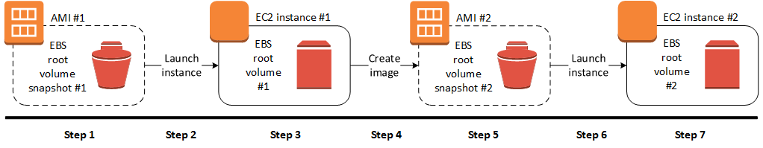
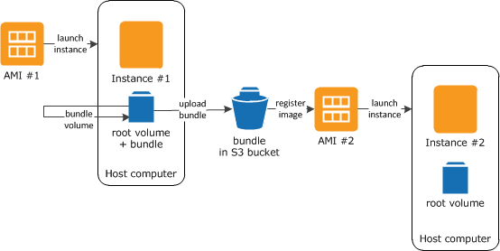
AWS EBS & Instance Store

Slide 42
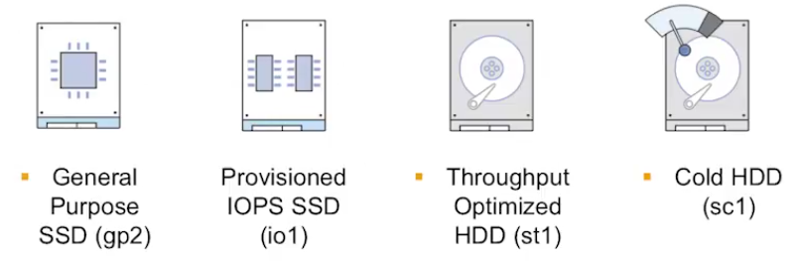
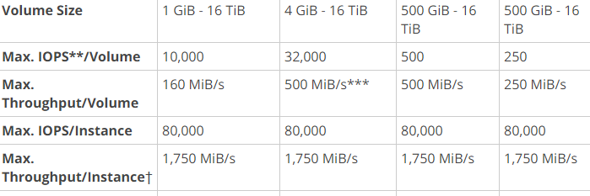
Choosing the EBS Volume Type
● Amazon EBS is persistent block storage
● 1GB to 16TB
● Max IOPS/Volume & Max IOPS/Instance
● https://docs.aws.amazon.com/AWSEC2/latest/UserGuide/EBSVolumeTypes.html

Slide 43

Increase EBS capacity with RAID
● RAID 0: When I/O performance is more important than fault tolerance.
● RAID 1: When fault tolerance is more important than I/O performance.
● RAID 5 & 6 are not recommended
● https://docs.aws.amazon.com/AWSEC2/latest/UserGuide/raid-config.html

Slide 44

Bootstrapping with EC2
● The process of automatically setting up your servers
Install latest software
Copy data from S3
Register with DNS
Start services
Update packages
Reboot
Open port 80, 443
Register with load balancer
Mount devices

Slide 45


EC2: User Data & Metadata
● User Data
Shell scripts
Cloud-init
● Metadata
HTTP GET
● https://docs.aws.amazon.com/AWSEC2/latest/UserGuide/ec2-instance-metadata.html

Slide 46

EC2: Resource Tagging
● To help you manage your EC2 resource
Key/Value
Bootstrapping scripts to configure EC2 Instances
● https://docs.aws.amazon.com/AWSEC2/latest/UserGuide/EC2_Resources.html

Slide 47


AWS EC2 - Instance LifeCycle

Slide 48


ELB: Application, Network & Classic
● High Availability
● Health Checks
● HTTP/ HTTPS
● Layer 4/ Layer 7 Load Balancing
● Monitoring
● https://aws.amazon.com/elasticloadbalancing/details/

Slide 49

ELB: Listeners & Health Checks
● Listener
● Health Check
● Across-AZs
● WebSocket Support
● Sticky Session
● Connection Draining (Default is 300s)
● Idle Connection (Default is 60s)
● https://docs.aws.amazon.com/elasticloadbalancing/latest/userguide/migrate-to-application-load-balancer.html

Slide 50


AWS ELB - Scalability
● Stable DNS host name resolves via round robin to ELB IP addresses in each Availability Zone.
● As traffic increases, AWS adds IP addresses to ELB’s DNS entry
● As traffic decreases, AWS automatically removes IP addresses from the ELB’s DNS entry

Slide 51

AWS EFS

Slide 52

AWS EFS
● More at: LinuxAcademy.Certified.Solutions.Architect_Associate.Level.2018

Slide 53

AWS EFS
● More at: LinuxAcademy.Certified.Solutions.Architect_Associate.Level.2018

Slide 54

AWS VPC

Slide 55

AWS VPC

Slide 57
VPC - Concept
A VPC resembles:
Private data centers
Private corporate networks
Private Network
Private and public subnets
Scalable infrastructure
Ability to extend corporate/home network to the cloud as if it were part of your network
VPC Scenarios
VPC with public subnet only – Single tier apps
VPC with public and private subnets – Resources that don’t need public internet access/layered apps
VPC with public and private subnets and hardware connected VPN – Extending to on-premises
VPC with a private subnet only and hardware VPN access

Slide 58

AWS VPC - Scenario 1: VPC with a Single Public Subnet

Slide 59

AWS VPC - Scenario 2: VPC with Public and Private Subnets (NAT)

Slide 60

AWS VPC - Scenario 3: VPC with Public and Private Subnets and AWS Managed VPN Access

Slide 61

AWS VPC - Scenario 4: VPC with a Private Subnet Only and AWS Managed VPN Access

Slide 62

AWS SG & ACL

Slide 63


AWS Peering
VPC Peering allows you to setup direct network routing between different VPCs using private IP addresses
Instances will communicate with each other as if they were on the same private network
VPC Peering can occur between other AWS accounts and other VPCs within the same region
● https://docs.aws.amazon.com/vpc/latest/userguide/vpc-peering.html

Slide 64
Session 2: Highly Available and Fault Tolerant VPC Networking
● DNS
● CDN
● Failover Networking

Slide 65

AWS Region & AZ
● Regions are completely separate clouds
● Multi network-connected Availability Zones in each Region
Skype: doanda86

Slide 66

AWS Route53

Slide 67

AWS Route53 - Alias Record

Slide 68

AWS Route53 - Weighted Round Robin

Slide 69

AWS Route53 - Latency Based Routing
Skype: doanda86

Slide 70

AWS ELB - Distribute load across Availability Zones
Skype: doanda86

Slide 71
AWS ELB - Scalability
● Stable DNS host name resolves via round robin to ELB IP addresses in each Availability Zone.
● As traffic increases, AWS adds IP addresses to ELB’s DNS entry
● As traffic decreases, AWS automatically removes IP addresses from the ELB’s DNS entry

Slide 72
AWS ELB: Application, Network & Classic
● Listener
● Health Checks
● Layer 4/ Layer 7 Load Balancing
● Across-AZs
● WebSocket Support
● Sticky Session
● Connection Draining (Default is 300s)
● Idle Connection (Default is 60s)
● https://aws.amazon.com/elasticloadbalancing/details/

Slide 73

AWS CloudFront - CDN
● Edge Locations
● Regional Edge Cache

Slide 74

CloudFront: Static & Dynamic Content
● Distribution of frequently-accessed static content
● Deliver dynamic web app over HTTP
● Stream audio & video file to web browsers
Skype: doanda86

Slide 75
Building Fault-Tolerant Applications on AWS
● Building Fault-Tolerant Applications on AWS

Slide 76

Amazon Machine Images
The template that you use to define your service instances is called an Amazon Machine Image (AMI). This template basically contains a software configuration (i.e., operating system, application server, and applications) and is applied to an instance type.
This is really just the first step towards fault-tolerance. At this point, you are able to quickly recover from failures; if an instance fails, or is not behaving the way you want it to, you can simply launch another one based on the same template.
To minimize downtime, you might even always keep a spare instance running – ready to take over in the event of a failure.

Slide 77
Elastic Block Store
Amazon Elastic Block Store (Amazon EBS) provides block level storage volumes for use with Amazon EC2 instances. Amazon EBS volumes are off-instance storage that persists independently from the life of an instance
Amazon EBS and Amazon EC2 are often used in conjunction with one another when building a fault-tolerant application on the AWS platform. Any data that needs to persist should be stored on Amazon EBS volumes, not on the so-called “ephemeral storage” associated with each Amazon EC2 instance.
If the Amazon EC2 instance fails and needs to be replaced, the Amazon EBS volume can simply be attached to the new Amazon EC2 instance. Since this new instance is essentially a duplicate of the original, there should be no loss of data or functionality
Amazon EBS volumes are highly reliable, but to further mitigate the possibility of a failure, backups of these volumes can be created using a feature called snapshots.

Slide 78

Elastic Block Store

Slide 79

Elastic IP Addresses
Elastic IP Addresses are public IP addresses that can be mapped (routed) to any EC2 instance within a particular EC2 Region.
The addresses are associated with an AWS account, not to a specific instance or the lifetime of an instance, and are designed to aid in the construction of fault-tolerant applications.
An elastic IP address can be detached from a failed instance and then mapped to a replacement instance within a very short time frame.

Slide 80
Failures Can Be Useful - Auto Scaling
Auto Scaling enables you to automatically scale your Amazon EC2 capacity up or down. You can define rules that determine when more (or fewer) server instances are needed, such as:
When the number of functioning server instances is above (or below) a certain number, launch (or terminate) server instances.
When the resource utilization (i.e. CPU, network or disk) of the server instance fleet is above (or below) a certain threshold, launch (or terminate) server instances. Such metrics will be collected from the Amazon CloudWatch service, which monitors Amazon EC2 instances.
This approach is ideal for Auto Scaling. To implement N + 1 with Auto Scaling, you simply define a rule that there should always be at least 2 instances of a given AMI available. If one instance fails, Auto Scaling will immediately launch a replacement & always ensure that you have 2 healthy server instances available.

Slide 81

Failures Can Be Useful - Elastic Load Balancing
Elastic Load Balancing is an AWS product that distributes incoming traffic to your application across several Amazon EC2 instances.
Elastic Load Balancing detects unhealthy instances within its pool of Amazon EC2 instances and automatically reroutes traffic to healthy instances, until the unhealthy instances have been restored

Slide 82

Building Multi-AZ Architectures to Achieve High Availability

Slide 83

Building Multi-AZ Architectures to Achieve High Availability
Elastic IP Addresses play a critical role in the design of a fault-tolerant application spanning multiple Availability Zones. The failover mechanism can easily re-route the IP address (and hence the incoming traffic) away from a failed instance or zone to a replacement instance.

Slide 84

Fault-Tolerant Building Blocks - SQS
Messages are stored in queues that you create – each queue is defined as a URL, so it can be accessed by any server that has access to the Internet
You can use Amazon SQS to help you ensure that your queue is always available; any messages that you send to a queue are retained for up to four days (or until they are read and deleted by your application)

Slide 85
Fault-Tolerant Building Blocks - S3
Amazon Simple Storage Service (Amazon S3) is a deceptively simple web service that provides highly durable, fault-tolerant data storage. Amazon Web Services is responsible for maintaining availability and fault-tolerance; you simply pay for the storage that you use.
Behind the scenes, Amazon S3 stores objects redundantly on multiple devices across multiple facilities in an Amazon S3 Region
Amazon S3's Versioning feature allows you to retain prior versions of objects stored in S3 and also protects against accidental deletions initiated by a misbehaving application. Versioning can be enabled for any of your S3 buckets.

Slide 86
Fault-Tolerant Building Blocks - RDS
Amazon Relational Database Service (Amazon RDS) is a web service that makes it easy to run relational databases in the cloud. In the context of building fault-tolerant and highly available applications, Amazon RDS offers several features to enhance the reliability of critical databases.
Automated backups of your database enable point-in-time recovery for your database instance. Amazon RDS will backup your database and transaction logs and store both for a user-specified retention period. This feature is enabled by default.
Amazon RDS also supports a Multi-AZ deployment feature. If this is enabled, a synchronous standby replica of your database is provisioned in a different Availability Zone. Updates to your DB Instance are synchronously replicated across Availability Zones to the standby in order to keep both databases in sync.

Slide 87
Using Amazon Web Services for Disaster Recovery
● https://d1.awsstatic.com/whitepapers/aws-disaster-recovery.pdf

Slide 88
Traditional DR Investment Practices
A traditional approach to DR involves different levels of off-site duplication of data and infrastructure. At a minimum, the infrastructure that is required to support the duplicate environment should include the following:
Facilities to house the infrastructure, including power and cooling.
Security to ensure the physical protection of assets.
Suitable capacity to scale the environment.
Support for repairing, replacing, and refreshing the infrastructure.
Contractual agreements with an Internet service provider (ISP) to provide Internet connectivity that can sustain bandwidth utilization for the environment under a full load.
Network infrastructure such as firewalls, routers, switches, and load balancers.
Enough server capacity to run all mission-critical services, including storage appliances for the supporting data, and servers to run applications and backend services such as user authentication, Domain Name System (DNS), Dynamic Host Configuration Protocol (DHCP), monitoring, and alerting.

Slide 89

AWS RTO/ RPO
● Recover Time Object (RTO) – Acceptable time period within which normal operation (or degraded operation) needs to be restored after event
● Recovery Point Object (RPO): – Acceptable data loss measured in time
● Using Amazon Web Services for Disaster Recovery

Slide 90

AWS Backup & Restore

Slide 91

AWS Backup & Restore
Select an appropriate tool or method to back up your data into AWS.
Ensure that you have an appropriate retention policy for this data.
Ensure that appropriate security measures are in place for this data, including encryption and access policies.
Regularly test the recovery of this data and the restoration of your system.

Slide 92

AWS Pilot Light
You need to have your regularly changing data replicated to the pilot light, the small core around which the full environment will be started in the recovery phase

Slide 93

AWS Pilot Light
To recover the remainder of the environment around the pilot light, you can start your systems from the AMIs within minutes on the appropriate instance types

Slide 94

AWS Warm Standby
A warm standby solution extends the pilot light elements and preparation. It further decreases the recovery time because some services are always running

Slide 95

AWS Warm Standby
In the case of failure of the production system, the standby environment will be scaled up for production load , and DNS records will be changed to route all traffic to AWS.

Slide 96

AWS Multi-Site
A multi-site solution runs in AWS as well as on your existing on-site infrastructure, in an active-active configuration.

Slide 97

AWS Multi-Site
Traffic is cut over to the AWS infrastructure by updating DNS, and all traffic and supporting data queries are supported by the AWS infrastructure.

Slide 98
Replication of Data
When you replicate data to a remote location, you should consider these factors:
Distance between the sites — Larger distances typically are subject to more latency or jitter.
Available bandwidth — The breadth and variability of the interconnections.
Data rate required by your application — The data rate should be lower than the available bandwidth.
Replication technology — The replication technology should be parallel (so that it can use the network
effectively).
There are two main approaches for replicating data: synchronous and asynchronous
Synchronous replication: Data is atomically updated in multiple locations. This puts a dependency on network performance and availability. In AWS, Availability Zones within a region are well connected, but physically separated.
Asynchronous replication: Data is not atomically updated in multiple locations. It is transferred as network performance and availability allows, and the application continues to write data that might not be fully replicated yet.

Slide 99
Failing Back from a Disaster
Backup and restore
Freeze data changes to the DR site.
Take a backup.
Restore the backup to the primary site.
Re-point users to the primary site.
Unfreeze the changes.
Pilot light, warm standby, and multi-site
Establish reverse mirroring/replication from the DR site back to the primary site, once the primary site has caught up with the changes.
Freeze data changes to the DR site.
Re-point users to the primary site.
Unfreeze the changes

Slide 100
Backup and Recovery Approaches Using AWS
● Backup and Recovery Approaches Using AWS

Slide 101
Why Use AWS as a Data-Protection Platform?
Amazon Web Services (AWS) is a secure, high-performance, flexible, cost effective, and easy-to-use cloud computing platform. AWS takes care of the undifferentiated heavy lifting and provides tools and resources you can use to build scalable backup and recovery solutions.
There are many advantages to using AWS as part of your data protection strategy:
Durability
Security
Global infrastructure
Compliance
Scalability
Lower TCO (Total cost of Ownership)
Pay-as-you-go pricing

Slide 102
AWS Storage Services for Data Protection
Amazon S3 and Amazon Glacier are ideal services for backup and archival. Both are durable, low-cost storage platforms. Both offer unlimited capacity and require no volume or media management as backup data sets grow. The pay-for-what-you-use model and low cost per GB/month make these services a good fit for data protection use cases:
Amazon S3
Amazon Glacier
AWS Storage Gateway
AWS Transfer Services

Slide 103
Designing a Backup and Recovery
You should implement backup processes that will offer the appropriate level of granularity to meet the RTO and RPO of the business, including:
File-level recovery
Volume-level recovery
Application-level recovery (for example, databases)
Image-level recovery
The following sections describe backup, recovery, and archive approaches based on the organization of your infrastructure. IT infrastructure can broadly be categorized as cloud native, on-premises, and hybrid.

Slide 104

Cloud-Native Infrastructure

Slide 105

Cloud-Native Infrastructure - Creating EBS Snapshots
When you create a snapshot, you protect your data directly to durable disk-based storage. You can use the AWS Management Console, the command line interface (CLI), or the APIs.

Slide 106


Cloud-Native Infrastructure - Restoring from an EBS Snapshot
Create a volume from the backup snapshot
Unmount the existing volume
Detach the existing from the instance
Attach the volume that was created from the snapshot
Remount the volume on the running instance

Slide 107
Cloud-Native Infrastructure - Database Backup Approaches
Amazon RDS provides two different methods for backing up and restoring your DB instances:
Automated backups enable point-in-time recovery of your DB instance. Automated backups are turned on by default when you create a new DB instance. Amazon RDS performs a full daily backup of your data during a window that you define when you create the DB instance. You can configure a retention period of up to 35 days for the automated backup.
DB snapshots are user-initiated backups that enable you to back up your DB instance to a known state as frequently as you like, and then restore to that state at any time.
When you restore a database to a point in time or from a DB snapshot, a new database instance with a new endpoint will be created. In this way, you can create multiple database instances from a specific DB snapshot or point in time.

Slide 108

Cloud-Native Infrastructure - Database Backup Approaches
AWS stores system images in what are called Amazon Machine Images (AMIs). These images consist of the template for the root volume required to launch an instance. You can use the AWS Management Console or the aws ec2 createimage CLI command to backup the root volume as an AMI.

Slide 109

On-Premises to AWS Infrastructure

Slide 110

On-Premises to AWS Infrastructure - With S3 & Glacier
Amazon S3 and Amazon Glacier are natively API-based and available through the Internet. This allows backup software vendors to directly integrate their applications with AWS storage solutions

Slide 111
On-Premises to AWS Infrastructure - With AWS Storage Gateway
Volume gateways: Volume gateways provide cloud-backed storage volumes that you can mount as Internet Small Computer System Interface (iSCSI) devices from your on-premises application servers.
Gateway-cached volumes
Gateway-stored volumes
Gateway-virtual tape library (gateway-VTL): With gateway-VTL, you can have a limitless collection of virtual tapes. Each virtual tape can be stored in a virtual tape library backed by Amazon S3 or a virtual tape shelf backed by Amazon Glacier.

Slide 112

Hybrid Environments

Slide 113

Hybrid Environments

Slide 114
Session 3: Database Service
● RDS
● DynamoDB
● Redshift
● ElastiCache

Slide 115


Storage & DB Options in AWS

Slide 116


Performance at Scale with ElastiCache
▶ Improves the performance of web app
▶ Reducing the load on the database
▶ Frequently used as a database front-end
● Memcached: A widely adopted memory object caching system
● Redis: Popular open source
Master/Slave, cross-AZ redundancy
Whitepapers: Performance at Scale with Amazon ElastiCache

Slide 117
Performance at Scale with ElastiCache
Is object caching your primary goal, for example to offload your database? If so, use Memcached.
Are you interested in as simple a caching model as possible? If so, use Memcached.
Are you planning on running large cache nodes, and require multithreaded performance with utilization of multiple cores? If so, use Memcached.
Do you want the ability to scale your cache horizontally as you grow? If so, use Memcached.
Does your app need to atomically increment or decrement counters? If so, use either Redis or Memcached.
Are you looking for more advanced data types, such as lists, hashes, and sets? Ifso, use Redis.
Does sorting and ranking datasets in memory help you, such as with leaderboards? If so, use Redis.
Are publish and subscribe (pub/sub) capabilities of use to your application? If so, use Redis.
Is persistence of your key store important? If so, useRedis.
Do you want to run in multiple AWS Availability Zones (Multi-AZ) with failover? If so, use Redis.
Whitepapers: Performance at Scale with Amazon ElastiCache

Slide 118

ElastiCache - MemCached
▶ Amazon ElastiCache does not directly communicate with your database tier, or indeed have any particular knowledge of your database.

Slide 119

ElastiCache - MemCached
▶ For development purposes, you can begin with a single ElastiCache node to test your application, and then scale to additional cluster nodes by modifying the ElastiCache cluster.

Slide 120

ElastiCache - MemCached with DynamoDB
▶ This combination of DynamoDB and ElastiCache is very popular with mobile and game companies, because DynamoDB allows for higher write throughput at lower cost than traditional relational databases.
▶ In addition, DynamoDB uses a key-value access pattern similar to ElastiCache, which also simplifies the programming model.

Slide 121

ElastiCache - Redis: Cluster
▶ Unlike Memcached, ElastiCache clusters for Redis only contain a single primary node.
▶ After you create the primary node, you can configure one or more replica nodes and attach them to the primary Redis node.

Slide 122

ElastiCache - Redis: Cluster
▶ In this pattern, you configure your application to send writes to the primary endpoint.
▶ Then you read from one of the replicas
▶ With this approach, you can scale your read and write loads independently, so your primary node only has to deal with writes.

Slide 123

ElastiCache - Sharding with Redis
▶ Redis has two categories of data structures: simple keys and counters, and multidimensional sets, lists, and hashes.
▶ The bad news is the second category cannot be sharded horizontally. But the good news is that simple keys and counters can.

Slide 124

ElastiCache - Sharding with Redis
How Sharding Works

Slide 125

ElastiCache - Redis with DynamoDB
▶ You configure your application with two separate sets of Redis handles, a write handle that points to the sharded masters and a read handle that points to the sharded replicas.
▶ Following is an example architecture, this time with Amazon DynamoDB rather than MySQL.

Slide 126

ElastiCache: Redis Cluster & Sharding Data

Slide 127

RDS: Engine Capacity
● Non OS
● Structured data - sophisticated querying and joining

Slide 128


RDS: Multi-AZ & Read Replicate
● Multi-AZ:
Sync replicating data between a primary instance & a standby instance in another AZ
When AZ failure, RDS will automatically failover to the standby
● Read Replica:
Asynchronously
Promote Read-Replica to Primary
Increase Read capacity
※ Amazon Aurora with Multi-Master
Read and write data to multiple database instances in a cluster

Slide 129

RDS Aurora & MySQL: Read Replicas
● https://aws.amazon.com/rds/aurora/faqs/

Slide 130

AWS DynamoDB

Slide 131
DynamoDB
Fully managed NoSQL database
Can scale up and down depending on demand without downtime or performance degradation
Manage data, not hardware or software
Built-in monitoring
Consistent and fast performance
Data is stored on fast SSDs
You control performance through read/write capacity
Can spread out load across servers and tables
Replication across multiple availability zones in an AWS region (high availability)
DynamoDB can be used via the AWS Console or API
Multi-language support through SDKs (JavaScript, PHP, Python, mobile, etc...)
Build-in features that speed up development
Command line interface

Slide 132

DynamoDB - Architecture

Slide 133

DynamoDB - Architecture
Tables replicated across 3 AZ by default
Cross region replication using DynamoDB Streams and the Cross Region Replication Library available on github
https://github.com/awslabs/dynamodb-cross-region-library

Slide 134

DynamoDB - Primary Key
Partition Key (also known as hash attribute)
Simple primary key composed of one attribute
Used to retrieve data; Must be unique
Partition and Sort (also known as range attribute) key
Composite primary key composed of two attributes: the partition key and sort key
Can have the same partition key, but must have a different sort key

Slide 135
DynamoDB - Limit
256 tables per region (can be increased on request)
Partition key length: 2048 bytes maximum, 1 byte minimum
Sort key length: 1024 bytes maximum, 1 byte minimum
Item size: 400KB including attribute name and value
Up to 10 CreateTable, UpdateTable, and DeleteTable actions running simultaneously
A single BatchGetItem operation can get a maximum of 100 items
Must be < 16MB in size
A single BatchWriteItem operation can contain up to 25 PutItem or DeleteItem requests
Total size of all items must be < 16 MB
Query and Scan result set is limited to 1 MB of data per call
LastEvaluatedKey in the response can be used to retrieve more

Slide 136
DynamoDB - RCU & WCU
Provisioning Reads and Writes:
Read Capacity Unit (RCU) provides one strongly consistent read (or two eventually consistent reads) per second for items < 4KB in size.
Write Capacity Unit (WCU) provides one write per second for items < 1KB in size.
Partition:
A partition is the storage building block of a DynamoDB table
Data is split across partitions for scaling (provisioned throughput)
Data spread according to:
Hash built on the Primary Key
Hash built on the Primary Key + Sort Key

Slide 137


DynamoDB - Partitioning

Slide 138


DynamoDB - Partitioning
A partition can support a maximum of 3000 RCUs OR 1000 WCUs
eg: If you provision 5500 RCUs and 1500 WCUs
( 5500 / 3000 ) + ( 1500 / 1000 ) = 3.333 => 4 partitions
Can hold approximately 10GB of data
eg: If you provision for 45 GB of data
( 45/10 ) = 4.5 => 5 partitions

Slide 139

DynamoDB - Partitioning
Provision for 5500 RCUs and 1500 WCUs; And Provision for 45 GB of data.
( 5500 / 3000 ) + ( 1500 / 1000 ) = 3.333 => 4 partitions
( 45/10 ) = 4.5 => 5 partitions
Max of the two partition calculations:

Slide 140

DynamoDB - Primary Keys Across Partition
Data in DynamoDB is spread across multiple DynamoDB partitions.
As the data grows and throughput requirements are increased, the number of partitions are increased automatically.
DynamoDB handles this process in the background.

Slide 141

DynamoDB - Hot Partition
3000 RCUs and 1000 WCUs provisioned: 2 partitions
Lots of items with the same partition ID

Slide 142


DynamoDB - Indexing - Primary Key
How can I get all the post where userid = 1?

Slide 143


DynamoDB - Indexing - Secondary
How can I get all the post where topic = Redhat?
Primary key does not help; Have to do a table scan - Takes too long

Slide 144

DynamoDB - Indexing - Secondary
How can I get all the post where topic = Redhat?
Create a secondary index with only the post id 'projected'
Use the secondary key for the lookup

Slide 145
DynamoDB - Indexing - Secondary
Indexes let you query data using alternate keys (more flexibility)
Can provide better performance
Local Secondary Index
Partition key must be the same but the sort key is different
“Local” because every partition is scoped to a table partition with the same partition key value
Uses table’s provisioned throughput
Eventual consistency or strong consistency
Global Secondary Index
Partition key and Sort key can both be different from those on the table
Has its own provisioned throughput
Eventual consistency
Up to 20 global and 5 local indexes per table

Slide 146

DynamoDB - Indexing - Attributes
Projected Attributes - Attributes copied from the table to the index, in addition to the primary key attributes and index key attributes
Projection Type:
KEY_ONLY: Only the index and primary keys are projected (smallest index - more performant)
INCLUDE: Only specified attributes are projected
ALL: All attributes are projected (biggest index - least performant)

Slide 147


DynamoDB - Indexing - Local Secondary Index (LSI)
Uses the primary key of the table but different sort keys; same attributes as the table
Most importantly they need to be created at the time of table creation and cannot be modified or deleted

Slide 148


DynamoDB - Indexing - Global Secondary Index (GSI)
Can use any attribute as secondary key, different sort key
Can be added to existing tables

Slide 149


DynamoDB - Indexing - Global Secondary Index (GSI)
Only users that have a certification

Slide 150
DynamoDB - Indexing - Secondary
When to use LSI
Index data size has to be less than 10GB
Just need to have an additional sort key using the same primary key
All of those were true at the time you created the table
Strong consistency is required
When to use GSI
Data size of the index is greater than 10GB
Eventual consistency works for you
Thought about it after you created the table
One of the attributes has too much data and it is not required; exclude it in the projected attributes

Slide 151
DynamoDB - Reading Data - Primary Key Lookup
Reading Data
Eventual Consistency Read (default) cho phép response data trong khoảng 1s.
Strong Consistency Read: Trả về kết quả ngay lập tức (dưới 1s)
Primary Key Lookup
Find items using only primary key values from a table or secondary index
Returns the items matching the primary key search
Very efficient because it searches indexes only
Returns all attributes of an item, or only the ones you want
Is eventually consistent by default but can request a strongly consistent read
Can use conditional operators and filters to return precise results

Slide 152


DynamoDB - Reading Data - Primary Key Lookup
GetItem API

Slide 153
DynamoDB - Reading Data - Query & Scan
Query
Allow you to find items using only primary key values from a table or secondary index
Benefits:
Returns the items matching the primary key search
Much more efficient because it searches indexes only
Returns all attributes of an item, or only the ones you want
Is eventually consistent by default but can request a consistent read
Can use conditional operators and filters to return precise results
Scan
Don't do it!!!
Reads every item in the table and is operationally inefficient
Scanning the whole table; Lots of RCUs if it is a big table
Looks for all items and attributes in a table by default
Benefits:
Scans can apply filters to the results to refine values
Can return only specific attributes with the ProjectionExpression parameter

Slide 154


DynamoDB - Reading Data - Query & Scan
Query API

Slide 155


DynamoDB - Reading Data - Query & Scan
Scan API

Slide 156
DynamoDB - Reading Data - Query & Scan
Negatives of Scan:
The larger the data set in the table the slower performance of a scan
The more filters on the scan the slower the performance
Returns only filtered results
Only eventually consistent reads are available
If you must SCANS: What you should keep in mind:
You can reduce Page Size of an operation with the Limit parameter, to limit how much data you try to retrieve at the same time
Avoid performing Scans on mission-critical tables
Program your application logic to retry any requests that receives a response code saying that you exceeded provisioned throughput (or increase throughput)

Slide 157

DynamoDB - Writing data
PutItem API

Slide 158

DynamoDB - Writing data - Atomic Counters
Allow you to increment or decrement the value of an attribute without interfering with other write requests
Requests are applied in the order that they are received
Updates are not idempotent - it will update the value each time it is called
Use case: Increasing view count

Slide 159

DynamoDB - Writing data - Conditional Writes
Helps coordinate writes
Checks for a condition before proceeding with the operation
Supported for PutItem, DeleteItem, UpdateItem operations
Specify conditions in ConditionExpression:
Can contain attribute names, conditional operators, and built-in functions
A failed conditional write returns ConditionalCheckFailedException

Slide 160
DynamoDB - Bad Use Cases & Best Practices
Bad Use Cases
Ứng dụng của bạn đòi hỏi một SQL interface
Các query mà đòi hỏi join
Data size lớn hơn 400KB mỗi item/row
Không thường xuyên access
Low throughput data
Full table scan on huge tables
Best Practices
Keep item size small
Store metadata trong DynamoDB và các BLOB trên S3
Sử dụng một table với một hash key cho extremely high scale
Tránh các hot key và hot partitions
Sử dung table mỗi ngày, mỗi tuần, mỗi tháng và store dữ liệu timeseries
Sử dụng conditional updates
Chạy một cache trên DynamoDB nếu cần
Test các application cần Scale
Không phụ thuộc vào burst capacity

Slide 161
DynamoDB - Granting temporary access
You can use temporary security credentials to make calls to AWS services
Example: Users on your mobile application need the ability to communicate with DynamoDB. How can you create permissions for each user to access DynamoDB resources needed for your mobile application to work?
Options:
IAM Roles.
Web Identity Federation: Bạn có thể cấp quyền truy cấp cho user khi họ signin đến hệ thống bên ngoài AWS IAM
Support 2 loại identity federation:
Enterprise identity federation: Xác thực các user trong network của công ty bạn
Web identity federation: User có thể sign in với AWS, Facebook, Google hoặc mọi OpenID Connect (OIDC) 2.0 compatible provider
Amazon Cognito.

Slide 162

DynamoDB - Granting temporary access - Enterprise identity federation
● Identity Providers and Federation

Slide 163

DynamoDB - Granting temporary access - Web identity federation
● Identity Providers and Federation

Slide 164


Centralized & Decentralized Data Stores
So move ...
● Session/state to Amazon DynamoDB
● DB caching to Amazon ElastiCache
● Static content to Amazon S3

Slide 165
Web/App architecture design
● https://aws.amazon.com/architecture/

Slide 166
AWS Auto-Scale
● https://d1.awsstatic.com/whitepapers/managing-your-aws-infrastructure-at-scale.pdf

Slide 167


Large Scale Event!
● Need more capacity than normally allocated for a period of time
● Sudden surge of users
● Reasonable cost
● https://docs.aws.amazon.com/autoscaling/ec2/userguide/auto-scaling-benefits.html

Slide 168
Provisioning New EC2 Instances
● Creating new instances or replicating existing environments
● Replacing a failed instance in an existing environment
● Responding to a “scale up” event to add additional instance to a Auto Scaling Groups
● Deploy a new version of your software stack
The process of automatically provisioning new instances and bringing them into service is known as bootstrapping
● AMI
● Dynamic configuration

Slide 169

Creating Your Own AMI: Base, Foundational, and Full AMI Models

Slide 170
Creating Your Own AMI: Base, Foundational, and Full AMI Models
In the base AMI model, only the OS image is maintained as an AMI. The AMI can be an AWS-managed image, or an AMI that you manage that contains your own OS image.
In the foundational AMI model, elements of a stack that change infrequently (for example, components such as the JVM and application server) are built into the AMI.
In the full stack AMI model, all elements of the stack are built into the AMI. This model is useful if your application changes infrequently, or if your application has rapid autoscaling requirements (which means that dynamically installing the application isn’t feasible). However, even if you build your application into the AMI, it still might be advantageous to dynamically configure the application at run time because it increases the flexibility of the AMI. For example, it enables you to use your AMIs across multiple environments

Slide 171


Creating Your Own AMI: Lifecycle
● AMI Lifecycle
● Launch Instance from AMI

Slide 172

Creating Your Own AMI: Managing AMI Builds

Slide 173
Dynamic Configuration: User Data & Metadata
● User Data
Shell scripts
Cloud-init
● Metadata
HTTP GET
● https://docs.aws.amazon.com/AWSEC2/latest/UserGuide/ec2-instance-metadata.html

Slide 174
Dynamic Configuration: Resource Tagging
● To help you manage your EC2 resource
Key/Value
Bootstrapping scripts to configure EC2 Instances
● https://docs.aws.amazon.com/AWSEC2/latest/UserGuide/EC2_Resources.html

Slide 175

Example

Slide 176
Dynamic Configuration: Using Configuration Management Tools
Configuration management tools allow you to define your environment’s configuration in code, you can track changes to the configuration and apply version control.
Configuration management tools typically leverage one of two models, push or pull
Push Models:
The master server needs to have information about the nodes that it needs to manage. When you use tools such as Auto Scaling, where nodes might come and go, this can be a challenge.
Push systems that do remote execution do not scale as well as systems where configuration changes are offloaded and executed locally on a node. In large environments, the master server might get overloaded when configuring multiple systems in parallel.
Connecting to nodes remotely requires you to allow specific ports to be allowed inbound to your nodes. For some remote execution tools, this includes remote SSH.

Slide 177
Dynamic Configuration: Using Configuration Management Tools
Pull Models:
Nodes can scale up and down easily, as the master does not need to know they exist before they can be configured. Nodes can simply register themselves with the server
Configuration management masters require less scaling when using a pull system because all processing is offloaded and executed locally on the remote node.
No specific ports need to be opened inbound to the nodes. Most tools allow the agent to communicate with the master server by using typical outbound ports such as HTTPS
Many configuration management tools work with AWS. Some of the most popular are Chef, Puppet, Ansible, and SaltStack.
Chef is an open source configuration management tool that uses an agent (chef-client) to pull configuration from a master server (Chef server)

Slide 178

Putting it all Together

Slide 179

Using AWS Services to Help Manage Your Environments

Slide 180
Using AWS Services to Help Manage Your Environments
Elastic Beanstalk takes care of deployment, capacity provisioning, load balancing, auto scaling, and application health monitoring. It is worth noting that Elastic Beanstalk is not a black box service: You have full visibility and control of the underlying AWS resources that are deployed, such as EC2 instances and load balancers.
Elastic Beanstalk supports deployment of Java, .NET, Ruby, PHP, Python, Node.js, and Docker on familiar servers such as Apache, Nginx, Passenger, and IIS
AWS OpsWorks is an application management service that makes it easy to deploy and manage any application and its required AWS resources.
AWS OpsWorks features a set of lifecycle events—Setup, Configure, Deploy, Undeploy, and Shutdown—that automatically run the appropriate recipes at the appropriate time on each instance.

Slide 181


Using AWS Services to Help Manage Your Environments
AWS CloudFormation
User Data
cfn-init

Slide 182

Managing Application and Instance State
● How to remove EC2 Instance from your environment, some reasons
Instance is terminated as a result of hardware/software
Scale down of Auto-Scaling group
Deploy a new version (using blue/green deployments)
● You need to ensure that application instances are stateless - This mean that all system and application state is stored and managed outside of the instance themselves

Slide 183

Managing Application and Instance State
● Structured Application Data
Amazon RDS
Amazon DynamoDB
● Unstructured Application Data
Amazon S3 (documents, images, binary data, …)
● User Session Data
Amazon ElastiCache
Amazon DynamoDB
● System Metrics - OS Level
CloudWatch
● Log Management
CloudWatch Logs
Amazon S3

Slide 184

AWS ELB, CloudWatch, and Auto Scaling
The features work together to help you to build highly scalable and highly available applications. Amazon CloudWatch monitors your Amazon EC2 capacity, Auto Scaling dynamically scales it based on demand, and Elastic Load Balancing distributes load across multiple instances in one or more Availability Zones.
● Elastic Load Balancing, Auto Scaling, and Amazon CloudWatch

Slide 185
ELB: Application, Network & Classic
● Listener
● Health Checks
● Layer 4/ Layer 7 Load Balancing
● Across-AZs
● WebSocket Support
● Sticky Session
● Connection Draining (Default is 300s)
● Idle Connection (Default is 60s)
● https://aws.amazon.com/elasticloadbalancing/details/

Slide 186

AWS Cloudwatch: Metric
● Metric are data about performance of your system
● Create Alarm with Metric
Select Metric
Define Alarm
Action

Slide 187

AWS Cloudwatch: Metric

Slide 188

AWS Auto-Scaling

Slide 189

1 User
● Amazon Route53 for DNS
● A single EIP
● A single EC2 Instance
● All on one Host
Web app
Database
Management

Slide 190

A Bigger Box
● Vertical Scale
● Simplest approach
● High Memory, I/O, CPU instances
● High storage of instances
● Easy to change instance sizes

Slide 191


Amazon Lightsail
● https://aws.amazon.com/lightsail/
Simple application
Small website and blogs
Development and test environments
● Templates
OS: Window Server, Amazon Linux, Ubuntu, Debian, …
App: WordPress, Redmine, Magento, Drupal, …
Stacks: Node.js, GitLab, LAMP, Nginx, ...

Slide 192

> 1 User
● Amazon Route53 for DNS
● A single Web Instance
● A single Database Instance
Use of a database service ?

Slide 193

Database Options

Slide 194


> 1000 User
● Amazon Route53 for DNS
● Elastic Load Balancing (ELB)
● Add another Web Instance

Slide 195

So if 10,000 ~ 100,000 Users ...

Slide 196

Move ...
● Static content to Amazon S3 and Amazon CloudFront

Slide 197


Move ...
● Session/state to Amazon DynamoDB
● DB caching to Amazon ElastiCache
● Dynamic content to Amazon CloudFront

Slide 198

> 100,000 User
● Multi-AZ
● Elastic Load Balancing between tiers
● Auto-Scaling
● Serving content smartly (Amazon S3/CloudFront
● Caching

Slide 199


Loose Coupling + SOA = Winning ...
● SOA
● Loose Coupling
Independent components
Design everything as a black box
Redundancy and scalability

Slide 200

> +++ User

Slide 201


Slide 202


Slide 203


Slide 204


Slide 205


Slide 206
AWS Blue/Green Deployment ...
●https://d1.awsstatic.com/whitepapers/AWS_Blue_Green_Deployments.pdf

Slide 207

AWS Blue/Green Deployment
Blue/green deployments provide near zero-downtime release and rollback capabilities. The fundamental idea behind blue/green deployment is to shift traffic between two identical environments that are running different versions of your application.

Slide 208
AWS Blue/Green Deployment
After you deploy the green environment, you have the opportunity to validate it. You might do that with test traffic before sending production traffic to the green environment, or by using a very small fraction of production traffic, to better reflect real user traffic. This is called canary analysis or canary testing.
Update DNS Routing with Amazon Route 53:
Single instances, with a public or Elastic IP address
Groups of instances behind an Elastic Load Balancing load balancer, or third-party load balancer
Instances in an Auto Scaling group with an Elastic Load Balancing load balancer as the front end
Services running on an Amazon EC2 Container Service (Amazon ECS) cluster fronted by an Elastic Load Balancing load balancer
Elastic Beanstalk environment web tiers
Other configurations that expose an IP or DNS endpoint

Slide 209

AWS Blue/Green Deployment
● Update DNS with Route53
Classic

Slide 210

AWS Blue/Green Deployment
● Update DNS with Route53
Classic DNS-weighted

Slide 211

AWS Blue/Green Deployment
● Update Auto-Scaling Group
● http://docs.aws.amazon.com/autoscaling/latest/userguide/as-enter-exit-standby.html

Slide 212

AWS Blue/Green Deployment
● Update Auto-Scaling Group

Slide 213

AWS Blue/Green Deployment
● Update Launch Configure

Slide 214

AWS Blue/Green Deployment
● Update Launch Configure

Slide 215

AWS Blue/Green Deployment
● Update Launch Configure

Slide 216

AWS Blue/Green Deployment
Swap the Environment of an Elastic Beanstalk:
Elastic Beanstalk provides several deployment policies that you can configure to use, ranging from policies that perform an in-place update on existing instances, to immutable deployment using a set of new instances.

Slide 217

AWS Blue/Green Deployment
● Swap the Environment of an Elastic Beanstalk

Slide 218

AWS Blue/Green Deployment
● Swap the Environment of an Elastic Beanstalk

Slide 219

AWS Blue/Green Deployment
Clone a Stack in AWS OpsWorks:
AWS OpsWorks has the concept of stacks, which are logical groupings of AWS resources (EC2 instances, Amazon RDS, Elastic Load Balancing, and so on) that have a common purpose and should be logically managed together.
Stacks are made of one or more layers.
A layer represents a set of EC2 instances that serve a particular purpose, such as serving applications or hosting a database server.

Slide 220

AWS Blue/Green Deployment
● Clone a Stack in AWS OpsWorks
Update DNS

Slide 221

AWS Blue/Green Deployment
● Clone a Stack in AWS OpsWorks
Update DNS

Slide 222
Best Practices for Managing Data Synchronization and Schema Changes
Both the blue and green environments need up-to-date data:
The green environment needs up-to-date data access because it’s becoming the new production environment.
The blue environment needs up-to-date data in the event of a rollback, when production is then either shifted back or kept on the blue environment.
The two approaches for performing the schema changes are often used in tandem:
The schema is changed first, before the blue/green code deployment. Database updates must be backward compatible, so the old version of the application can still interact with the data.
The schema is changed last, after the blue/green code deployment. Code changes in the new version of the application must be backward compatible with the old schema.

Slide 223

Best Practices for Managing Data Synchronization and Schema Changes
Schema modifications in the former approach are often additive. You add fields to tables, new entities, and relationships. If needed, you can use triggers or asynchronous processes to populate these new constructs with data based on data changes performed by the old application version.
You need to follow coding best practices when developing applications to ensure your application can tolerate the presence of additional fields in existing tables, even if they are not used. When table row values are read and mapped into source code structures (objects, array hashes, etc.), your code should ignore fields it can’t map instead of causing application runtime errors.

Slide 224
When Blue/Green Deployments Are Not Recommended
Are your schema changes too complex to decouple from the code changes? Is sharing of data stores not feasible?
Does your application need to be “deployment aware”?
Does your commercial off-the-shelf (COTS) application come with a predefined update/upgrade process that isn’t blue/green deployment friendly?

Slide 225
Session 4: Storage Service
● S3
● Glacier

Slide 226
Best Practices for Managing Data Synchronization and Schema Changes
Schema modifications in the latter approach are often deletive. You remove unneeded fields, entities, and relationships, or merge and consolidate them. By this time, the old application version is no longer operational
There’s an increased risk involved when managing schema changes in this way: failures in the schema modification process can impact your production environment. Your additive changes can bring down the old application because of an undocumented issue where best practices weren’t followed or where the new application version still has a dependency on a deleted field somewhere in the code.
To mitigate risk appropriately, this pattern places a heavy emphasis on your pre-deployment software lifecycle steps. Be sure to have a strong testing phase and framework and a strong QA phase. Performing the deployment in a testing environment can help identify these sorts of issues early, before the push to production

Slide 227

Amazon S3
Simple
Object store (size from zero to 5 TB)
Write once, read many (WORM)
Unlimited storage capacity
99,999999999% durability of Objects
99,99% availability of Object
Versioning control
Amazon S3 can serve as an origin store with CloudFront
Static content, include HTML files, images, videos and client-site script such as JavaScript.
Data store for computation and large-scale analytics

Slide 228


Setting up an EC2 Instance with IAM Roles and the Python Boto3 SDK
Creating a IAM Role
Creating a EC2 Instance
Attach IAM Role to EC2 Instance

Slide 229


Configuring the Boto3 SDK With API Credentials
Creating a IAM User with Credentials
Creating a EC2 Instance
Config Access Key to EC2 Instance

Slide 230
Amazon S3
Objects are static files that contain metadata information
Set of name-key pairs.
Cannot be changed after uploaded
Contains information specified by the user but also AWS information such as storage type
Bucket name restrictions:
Must be unique
Should comply with DNS naming conventions
Minimum of 3 and no more than 63 characters long
Can only contain lowercase letters, numbers, periods and hyphens
Ký tự bắt đầu là chữ hoặc số - nhưng không được dấu chấm, dấu gạch nối
Periods and hyphens cannot follow each other (i.e linuxacdemy-.com)
Must not be an IP address format (i.e 10.2.1.2)

Slide 231

Amazon S3 - Multi Upload
Objects larger than 5 GB require using the Multipart Upload API
● Can upload independently, in any order, and in parallel
● If any part fails to upload, you can retransmit that part
● You can pause and resume uploads
● You can upload objects as they are being created
● Object is reassembled after calling CompleteMultiPartUpload API
● Multipart Upload is recommend for files larger than 100MB

Slide 232

S3 - Data Consistency
AWS S3
Read-after-write Consistency chỉ đối với PUTS new Object, cho phép bạn truy xuất Object ngay lập tức sau khi bạn tạo nó.
Eventual Consistency xay ra doi voi Overwrite PUTS & DELETES; Có thể return giá trị cũ (yêu cầu phải đồng bộ all).
AWS DynamoDB
Eventual Consistency Read (default) cho phép response data trong khoảng 1s.
Strong Consistency Read: Trả về kết quả ngay lập tức (dưới 1s)

Slide 233

S3 - Performance
Amazon S3 có thể scale đến lượng request rates rất cao.
Bursts là số request mỗi giây
300 PUT/LIST/DELETE
800 GET
Contact Amazon to prepare and avoid temporary limits.
Consistent high number of requests per second
100 PUT/LIST/DELETE
300 GET
Follow the best practice guidelines to avoid overwhelming the I/O capacity of a partition.
Best Practices Design Patterns: Optimizing Amazon S3 Performance

Slide 234


S3 - Performance
Amazon S3 có một index cho object key names trong mỗi AWS region
Object key được store across đến nhiều partitions trong index đó
Key name được sử dụng để quyết định partition để chứa key
Performance Design Patterns for Amazon S3

Slide 235

S3 - Performance – GET-intensive workloads
Use Amazon CloudFront
Distributes content with low latency and high transfer rate
Caches objects
Fewer direct requests to S3
S3 – Error Handling
Understanding common errors
Error codes are generally handled with HTTP responses
404 Not Found
403 Forbidden
400 Bad Request
409 Conflict
500 Internal Server Error
Amazon S3 - Error Responses

Slide 236
S3 - Hosting Static Websites
S3 allows you to host static HTML files
Can specify index file
Can specify custom error file
Supports custom domains and redirects
Amazon S3 gives a default URL
Redirect from www.linuxacademy.com to linuxacademy.com
Bucket name must match domain name
Route 53 integration for custom domains
Configuring a Webpage Redirect

Slide 237


S3 - Hosting Static Websites
● Marketing websites
● Team homepages
● Small websites for a department, project
● Image files, video files
● Ect.

Slide 238
S3 - Website hosting using Amazon S3
Tạo Hosted Zone trên Route53 - s3staticdemo.framgia.vn
SN & SOA record set
Copy value → để routing traffic đến Hosted Zone trên Route53
Tạo một record set, trỏ Hosted Zone → mapping đến S3 Endpoint
Alias = Yes
Trường hợp redirect tất cả request từ www.s3staticdemo.framgia.com đến s3staticdemo.framgia.com
Tạo 1 S3 mới, setting "Redirect all requests to another hostname"
Chọn target là đến S3 s3staticdemo.framgia.vn
Tạo một record set, trỏ Hosted Zone → mapping đến S3 Endpoint mới
Thêm Name: www.
Alias = Yes

Slide 239

S3 - Website hosting using Amazon S3

Slide 240

S3 - Enabling CORS Configuration
Enable CORS (Cross-Origin Resource Sharing) configuration
This will allow us to share resources from one bucket to another while using S3 buckets for website hosting.

Slide 241

Amazon S3 - Control Access
● Use Amazon S3 policies, ACLs or IAM to define rules
● Apply policies to buckets and objects
Used for permissions such as granting access to an anonymous User
Restricting access based off of IP address
Restricting access based off of HTTP Referrer

Slide 242

S3 - Bucket Policy Example
Bucket Policy Examples

Slide 243

S3 - Bucket Policy Example
Bucket Policy Examples

Slide 244

S3 - Object Versioning
Allows for multiple versions of an object
Protects against unintended overwrites and deletions
Automatically archives objects
Versioning is at the bucket level
Configured via the Console or SDKs
Enabling Versioning
Existing objects are unchanged
Added objects are given unique version IDs
Automatically generated by S3
Disabling Versioning
Once version-enabled, a bucket cannot go back to being in an unversioned state
You can suspend versioning
Future objects are given a version ID of null
Already versioned objects do not change
To permanently delete a version, specify an ID
Object Versioning

Slide 245

S3 - Object Versioning
All versions remain in the bucket but S3 inserts a delete marker
The delete marker becomes the current version
By default, GET requests retrieve the latest version
If the current version has a delete marker, it returns a 404 Not Found error
You can get previous versions, however, by specifying an ID
Object Versioning

Slide 246


S3 - Object Versioning
To permanently delete a version, specify an ID
Any earlier version can be restored
Copying a previous version into the same bucket will restore it as the current version
Permanently delete the current version (by specifying its ID)
Copying an earlier version GETs the version and PUTs it in the bucket, giving it a new ID
That new ID is the used as the current version
Object Versioning

Slide 247

S3 - Object Versioning
Lifecycle Management can dictate what happens to versions after a certain amount of time
Example: Send noncurrent versions to Amazon Glacier after 30 days
Example: Permanently delete objects 180 days after they become noncurrent
Can have separate policies for current and noncurrent versions
Object Versioning

Slide 248


S3 - Protecting data using encryption
Protecting data in-transit
Using SSL or client-side encryption
Protecting data at rest
Request Amazon S3 to encrypt objects

Slide 249
S3 - Protecting data in-transit
Using an AWS KMS-managed customer master key (CMK)
Client gets a unique encryption key for each object
On upload:
Client first sends a request to AWS KMS for a key
AWS KMS returns an encryption key (plain text used to encrypt object data, and a cipher blob to upload to S3 as object metadata)
On download:
Client downloads the encrypted object from S3 with the cipher blob stored in metadata
The client then sends that cipher blob to AWS KMS to get the plain text
Plain text is used to decrypt the object
Protecting Data Using Client-Side Encryption

Slide 250
S3 - Protecting data in-transit
Using a client-side master key
Master keys and unencrypted data are never sent to AWS
On upload:
Client provides a master key to the Amazon S3 encryption client
The S3 client generates a random data key and encrypts it with your master key
The S3 client encrypts your data using the data key, and uploads a material description as part of the object metadata (x-amz-meta-x-amz-key)
On download:
Client downloads encrypted object along with its metadata
That metadata tells the client which master key to use to decrypt
Using that master key, the client decrypts the data key
The data key is used to decrypt the object
Protecting Data Using Client-Side Encryption

Slide 251
S3 - Protecting data at rest
Amazon S3-Managed Encryption (SSE-S3)
Amazon S3 provides server side encryption before saving data to disk
Add the x-amz-server-side-encryption request header to your upload request
Uses AES-256 (Advanced Encryption Standard)
Bucket policies can require all objects to use server-side encryption (SSE)
KMS-Managed Encryption Keys (SSE-KMS)
Uses customer master keys (CMKs)
Gives you more flexibility in controlling keys
Customer-Provided Encryption Keys (SSE-C)
Gives you the option to generate your own keys outside of the AWS environment
Amazon does not store your encryption key
Protecting Data Using Server-Side Encryption

Slide 252
Amazon S3 Storage Class
● Standard
Designed to provide high durability and high availability of objects over a given year
Designed to sustain the concurrent loss of data in two facilities
● Reduced Redundancy Storage (RRS)
Reduces costs by storing data at lower levels of redundancy than the Standard Storage
Designed to provide high durability and high availability of objects over a given year
Objects you can afford to lose or can recreate e.g. different encodings of movie media
● Glacier
Suitable for archiving data
Data retrieval time is 3-5 hour
Designed for high durability of archives
Cost effective-Write-once,read-never.
$0.01 per GB for storage
Pay for accessing data

Slide 253


Slide 254

Amazon S3 - Object Lifecycle & Glacier
● Automated management of objects
● Object Expiration – Permanently delete objects from Amazon S3
● Object Archival – Move objects to Glacier and out of Amazon S3 storage

Slide 255
Amazon Storage Gateway

Slide 256

Amazon Storage Gateway
● Connects local data center software application to cloud based storage such as Amazon S3
● VMWare or Hyper-V
● More at: LinuxAcademy.Certified.Solutions.Architect_Associate.Level.2018

Slide 257

Amazon Storage Gateway
● Gateway-Cached Volumes
Creates and mounts storage volumes as iSCSI devices on the on-premise servers
Stored the data written to this volume in Amazon S3 and will cache frequently access data on-premise in the storage device
● More at: LinuxAcademy.Certified.Solutions.Architect_Associate.Level.2018

Slide 258

Amazon Storage Gateway
● Gateway-Stored Volumes
Stores all the data locally (on-premise) in storage volumes
Periodically takes snapshots of the data as incremental backups and stores them on Amazon S3
● More at: LinuxAcademy.Certified.Solutions.Architect_Associate.Level.2018

Slide 259

Amazon Storage Gateway
● Gateway Virtual Tape Library: Gateway-VTL provides cost-effective and durable archival of backup data in Amazon Glacier.
Virtual tape library
Virtual tape shelf
● More at: LinuxAcademy.Certified.Solutions.Architect_Associate.Level.2018

Slide 260
Amazon Snowball

Slide 261

Amazon Snowball
AWS Snowball (also referred to as Import/Export) allows you to migrate huge amounts of data (petabytes) in and out of AWS using physical storage appliances.
Just request AWS Snowball from your AWS Console and an appliance(s) will be shipped to you.
Concept:
Data 256-bit encryption using Amazon KMS
High speed data transfer (80TB/day using 10G ports)
Industry standard (NIST 800-88) data wiping prior to re-use
Appliance tracking at every stage, including intrusion detection
Multiple appliances at a time to move vast amounts of data

Slide 262


Amazon Snowball

Slide 263
Session 5: Hybrid Environment
● VPN
● AWS Direct Connect
● VPC Peering

Slide 264
What is the LAN (Local Network)?
● How to Connect Head Office & Branch?

Slide 265
Wireless and Cable

Slide 266
What is the WAN?
● Another solution?

Slide 267
What is the VPN?

Slide 268
What is the VPN?

Slide 269
VPN: Site-to-Site

Slide 270

AWS VPN
● Whitepaper: Amazon Virtual Private Cloud Connectivity Options

Slide 271

AWS VPN
● Whitepaper: Amazon Virtual Private Cloud Connectivity Options

Slide 272

AWS VPN CloudHub

Slide 273

Software VPN

Slide 274
Amazon Direct Connect
● Whitepaper: Amazon Virtual Private Cloud Connectivity Options

Slide 275

AWS Direct Connect
AWS Direct Connect allows you to connect your on premise infrastructure or data center directly to the Amazon Cloud by using a dedicated connection and bypassing the public internet
Consistent performance
1Gbp/s and 10Gbp/s connections available from AWS
50M, 100M, 200M, 300M, 400M and 500M pipes available from APN Partners
Scales per transmission requirements
Lower egress bandwidth cost
Multiple AWS accounts can share a Direct Connect connection
No SLA

Slide 276

AWS Direct Connect

Slide 277

AWS Direct Connect Plus VPN

Slide 278

AWS Direct Connect
Point of presence within the Direct Connect location:
1G, 10G pipes
Connect to APN Direct Connect Partner:
50M, 100M, 200M, 300M, 400M and 500M pipes
Use a private virtual interface to connect to each VPC
Use a public virtual interface to public endpoints
Each connection is a separate VLAN
Routing based on BGP; limit on routes

Slide 279
Amazon VPC-to-Amazon VPC
● Whitepaper: Amazon Virtual Private Cloud Connectivity Options

Slide 280

Amazon VPC-to-Amazon VPC - VPC Peering

Slide 281

Amazon VPC-to-Amazon VPC - Software VPN

Slide 282

Amazon VPC-to-Amazon VPC - Software-to-AWS Managed VPN

Slide 283

Amazon VPC-to-Amazon VPC - Managed VPN

Slide 284

Amazon VPC-to-Amazon VPC - AWS Direct Connect

Slide 285

Amazon VPC-to-Amazon VPC - Private Link

Slide 286
Software Remote-Access VPN
● Whitepaper: Amazon Virtual Private Cloud Connectivity Options

Slide 287

Software Remote-Access VPN

Slide 288

Software Remote-Access VPN

Slide 289
Session 6: AWS Security Best Practices

Slide 290
Understanding the AWS Secure Global Infrastructure
The AWS secure global infrastructure and services are managed by AWS and provide a trustworthy foundation for enterprise systems and individual applications.
Using the IAM Service
The IAM service is one component of the AWS secure global infrastructure. With IAM, you can centrally manage users, security credentials such as passwords, access keys, and permissions policies that control which AWS services and resources users can access.
Regions, Availability Zones, and Endpoints
Use AWS regions to manage network latency and regulatory compliance. When you store data in a specific region, it is not replicated outside that region.
Regions are designed with availability in mind and consist of at least two, often more, Availability Zones. Availability Zones are designed for fault isolation.

Slide 291


Slide 292
Using the Trusted Advisor Tool
Some AWS Premium Support plans include access to the Trusted Advisor tool, which offers a one-view snapshot of your service and helps identify common security misconfigurations, suggestions for improving system performance, and underutilized resources.
Limited access to common administrative ports to only a small subset of addresses. This includes ports 22 (SSH), 23 (Telnet) 3389 (RDP), and 5500 (VNC).
Limited access to common database ports. This includes ports 1433 (MSSQL Server), 1434 (MSSQL Monitor), 3306 (MySQL), Oracle (1521) and 5432 (PostgreSQL).
IAM is configured to help ensure secure access control of AWS resources.
Multi-factor authentication (MFA) token is enabled to provide two-factor authentication for the root AWS account

Slide 293

Using the Trusted Advisor Tool

Slide 294


Secure Your Data - Storing and Managing Encryption Keys in the Cloud
AWS provides an HSM service in the cloud, known as AWS CloudHSM. Alternatively, you can use HSMs that store keys on premises, and access them over secure links, such as IPSec virtual private networks (VPNs) to Amazon VPC, or AWS Direct Connect with IPSec.

Slide 295

Secure Your Data - Storing and Managing Encryption Keys in the Cloud
AWS Key Management Service (KMS) is a managed service that makes it easy for you to create and control the encryption keys used to encrypt your data.
Encrypt, decrypt, and re-encrypt data
Generate data encryption keys that you can export from the service in plaintext or encrypted under a master key that doesn't leave the service
Generate random numbers suitable for cryptographic applications

Slide 296


Secure Your Data - Storing and Managing Encryption Keys in the Cloud
Typically, you use CMKs to generate, encrypt, and decrypt the data keys that you use outside of AWS KMS to encrypt your data.

Slide 297

Secure Your Data - Protecting Data at Rest
Protecting Data at Rest on Amazon S3
Protecting Data at Rest on Amazon EBS
Protecting Data at Rest on Amazon RDS
Protecting Data at Rest on Amazon Glacier
Protecting Data at Rest on Amazon DynamoDB
Protecting Data at Rest on Amazon EMR

Slide 298

Secure Your Data - Protecting Data at Rest

Slide 299

Secure Your Data - Decommission Data and Media Securely
When you ask AWS to delete data in the cloud, AWS does not decommission the underlying physical media; instead, the storage blocks are marked as unallocated. AWS uses secure mechanisms to reassign the blocks elsewhere.

Slide 300

Secure Your Data - Protect Data in Transit

Slide 301

Secure Your Data - Protect Data in Transit
When accessing applications running in the AWS public cloud, your connections traverse the Internet. In most cases your security policies consider the Internet an insecure communications medium and require application data protection in transit.
HTTP/HTTPS traffic (web applications)
HTTPS offload (web applications)
Remote Desktop Protocol (RDP) traffic
Secure Shell (SSH) traffic
Database server traffic

Slide 302
Secure Your Data - Protecting Data in Transit when Managing AWS Services
You can manage your services from AWS, such as Amazon EC2 and Amazon S3, using the AWS Management Console or AWS APIs.
The AWS Management Console uses SSL/TLS between the client browser and console service endpoints to protect AWS service management traffic.
Traffic is encrypted, data integrity is authenticated, and the client browser authenticates the identity of the console service endpoint by using an X.509 certificate.
You can alternatively use AWS APIs to manage services from AWS either directly from applications or third-party tools, or via SDKs, or via AWS command line tools.
AWS APIs are web services (REST) over HTTPS. SSL/TLS sessions are established between the client and the specific AWS service endpoint, depending on the APIs used, and all subsequent traffic, including the REST envelope and user payload, is protected within the SSL/TLS session.

Slide 303

Secure Your Data - Protecting Data in Transit to Amazon S3
Like AWS service management traffic, Amazon S3 is accessed over HTTPS. This includes all Amazon S3 service management requests as well as user payload, such as the contents of objects being stored/retrieved from Amazon S3, and associated metadata.

Slide 304

Secure Your Data - Protecting Data in Transit
Protecting Data in Transit to Amazon RDS
Protecting Data in Transit to Amazon DynamoDB
Protecting Data in Transit to Amazon EMR

Slide 305
Secure Your OS and Applications
With the AWS shared responsibility model, you manage your operating systems and applications security. Amazon EC2 presents a true virtual computing environment, in which you can use web service interfaces to launch instances with a variety of operating systems with custom preloaded applications.
Recommendations include:
Disable root API access keys and secret key
Restrict access to instances from limited IP ranges using Security Groups
Password protect the .pem file on user machines
Delete keys from the authorized_keys file on your instances when someone leaves your organization or no longer requires access
Rotate credentials (DB, Access Keys)
Regularly run least privilege checks using IAM user Access Advisor and IAM user Last Used Access Keys
Use bastion hosts to enforce control and visibility

Slide 306
Secure Your OS and Applications - Bootstrapping
After the hardened AMI is instantiated, you can still amend and update security controls by using bootstrapping applications.
Common bootstrapping applications include Puppet, Chef, Capistrano, Cloud-Init and Cfn-Init.
You can also run custom bootstrapping Bash or Microsoft Windows PowerShell scripts without using third-party tools.
Here are a few bootstrap actions to consider:
Security software updates install the latest patches, service packs, and critical updates beyond the patch level of the AMI.
Initial application patches install application level updates, beyond the current application level build as captured in theAMI.
Contextual data and configuration enables instances to apply configurations specific to the environment in which they are being launched–production, test, or DMZ/internal, for example.
Register instances with remote security monitoring and management systems

Slide 307
Secure Your OS and Applications - Protecting Your System from Malware
Protect your systems in the cloud as you would protect a conventional infrastructure from threats such as viruses, worms, Trojans, rootkits, botnets, and spam.
It’s important to understand the implications of a malware infection to an individual instance, as well as to the entire cloud system:
When a user–wittingly or unwittingly–executes a program on a Linux or Windows system, the executable assumes the privileges of that user (or in some cases, impersonates another user).
The code can carry out any action that the user who launched it has permissions for.
Users must ensure that they only execute trusted code.
Untrusted AMI
Untrusted software﻿
Untrusted software depots
Principle of least privilege﻿﻿
Patching﻿
Botnets
Spam
Antivirus/Antispam Software
Host-based IDS software

Slide 308

Secure Your Infrastructure - Public Subnet & Private Subnet
● Public Subnet
With IP Global
Could direct-access from Internet
● Private Subnet
Only IP Private
Could NOT direct-access from Internet

Slide 309

Secure Your Infrastructure - Security Group

Slide 310

Secure Your Infrastructure - Security Group & Bastion Host
● Protect Web/App Servers
● Allow/Deny traffic Inbound/Outbound

Slide 311

Secure Your Infrastructure - Networking

Slide 312

Secure Your Infrastructure - Securing Periphery Systems: User Repositories, DNS, NTP

Slide 313


Secure Your Infrastructure - VPN & Direct Connect

Slide 314

Secure Your Infrastructure - Building Threat Protection Layers

Slide 315


Manage Security Monitoring, Alerting, Audit Trail, and Incident Response

Slide 316

Manage Security Monitoring, Alerting, Audit Trail, and Incident Response

Slide 317

Manage Security Monitoring, Alerting, Audit Trail, and Incident Response

Slide 318
How AWS help you
● Private Subnet, Public Subnet
● Security Group, Network ACL
● Key pair (Private Key & Public Key)
● HTTP/ HTTPS
● Data Encryption
● IAM User (Access Key & Secret Key)
● IAM Role - Instance Profile
● Server-side Encryption & Client-side Encryption
● Store Logs
● Penetration testing
● Traditional Network Security
DDoS Attack
MITM Attack
IP Spoofing
Port Scanning
Packet Sniffing
● How to use AWS Security Checklist

Slide 319
Session 7: AWS Access Management
● AWS Account
● IAM
● AWS Organization

Slide 320
Manage AWS Accounts, IAM Users, Groups, and Roles
AWS account: This is the account that you create when you first sign up for AWS. Your AWS account represents a business relationship between you and AWS. AWS accounts have root permissions to all AWS resources and services, so they are very powerful.
IAM users: With IAM you can create multiple users, each with individual security credentials, all controlled under a single AWS account. IAM users can be a person, service, or application that needs access to your AWS resources through the management console, CLI, or directly via APIs.
Each AWS account or IAM user is a unique identity and has unique long-term credentials. There are two primary types of credentials associated with these identities:
(1) those used for sign-in to the AWS Management Console and AWS portal pages
(2) those used for programmatic access to the AWS APIs.

Slide 321

Manage AWS Accounts, IAM Users, Groups, and Roles

Slide 322

Manage AWS Accounts, IAM Users, Groups, and Roles

Slide 323

Enable MFA with Root Account

Slide 324
AWS IAM (Identity and Access Management)
AWS Identity and Access Management (IAM) enables you to manage access to AWS services and resources securely. Using IAM, you can create and manage AWS users and groups, and use permissions to allow and deny their access to AWS resources.
IAM User
IAM Role
IAM Group
IAM Policy

Slide 325


AWS IAM Policy
- By default, all requests are denied. (In general, requests made using the account credentials for resources in the account are always allowed.) - An explicit allow overrides this default. - An explicit deny overrides any allows.

Slide 326


AWS IAM: IAM User & IAM Role
● IAM User:
Access Key & Secret Key
Password AWS Console
● IAM Role: Temporary security credentials
EC2: Instance profile

Slide 327


AWS IAM: IAM User & IAM Role
● IAM User
AWS Management Console access
Programmatic access
Access/Secret key
● IAM Role
AWS service
Another AWS account
Web identity
SAML

Slide 328
AWS IAM Role: Examples

Slide 329

AWS Service that work with IAM
Amazon Resource Names (ARNs) uniquely identify AWS resources. We require an ARN when you need to specify a resource unambiguously across all of AWS, such as in IAM policies, Amazon Relational Database Service (Amazon RDS) tags, and API calls.
When you create IAM policies or work with Amazon Resource Names (ARNs), you identify an AWS service using a namespace. For example, the namespace for Amazon S3 is s3, and the namespace for Amazon EC2 is ec2. You use namespaces when identifying actions and resources.
● AWS Services That Work with IAM

Slide 330

AWS Service that work with IAM
Identity-based policies are attached to an IAM user, group, or role. These policies let you specify what that identity can do (its permissions). For example, you can attach the policy to the IAM user named John, stating that he is allowed to perform the Amazon EC2 RunInstances action.
Resource-based policies are attached to a resource. For example, you can attach resource-based policies to Amazon S3 buckets, Amazon SQS queues, and AWS Key Management Service encryption keys.
● AWS Services That Work with IAM

Slide 331

Understanding Delegation Using IAM Roles and Temporary Security Credentials
IAM Roles for Amazon EC2
An administrator uses IAM to create the Get-pics role. In the role, the administrator uses a policy that specifies that only Amazon EC2 instances can assume the role and that specifies only read permissions for the photos bucket.
A developer launches an Amazon EC2 instance and associates theGetpics role with that instance.
When the application runs, it retrieves credentials from the instance metadata on the Amazon EC2 instance.
Using the role credentials, the application accesses the photobucket with read-only permissions

Slide 332

Understanding Delegation Using IAM Roles and Temporary Security Credentials
Cross-Account Access
To establish cross-account access, in the trusting account (Account A), you create an IAM policy that grants the trusted account (Account B) access to specific resources.
Account B can then delegate this access to its IAM users.
Account B cannot delegate more access to its IAM users than the permissions that it has been granted by Account A.

Slide 333

AWS Organization
AWS Organizations Documentation

Slide 334


Slide 335

AWS Organization
AWS Organizations Documentation

Slide 336

AWS Organization
How to Use AWS Organizations to Automate End-to-End Account Creation

Slide 337
Session 8: Application and Messaging Service
● SNS, SQS, SES
● SWF

Slide 338

AWS SQS
● Hosted queue for storing messages as they travel between computers or processes
● Move data between distributed components of their applications
Standard Queue: Best-effort ordering which ensures that messages are generally delivered in the same order as they are sent.
First-in-First-out (FIFO) Queue: exactly-once processing: the order in which messages are sent and received is strictly preserved

Slide 339

AWS SQS - How to Work

Slide 340

AWS SQS - How to Work

Slide 341

AWS SQS - Visibility Timeout

Slide 342

AWS SQS - Delay Queues

Slide 343

AWS SQS - Message Attributes

Slide 344

AWS SQS - Short Polling & Long Polling
● Short polling returns a result immediately, even if the queue is empty. It also only checks a subset of servers, which could cause false empty responses.
● Long polling doesn’t return a response until there is a message in the queue. It also checks every server to avoid false empty responses.
● Long polling should be used when possible, because it can reduce costs and false empty responses.
Set ReceiveMessageWaitTimeSeconds: 1 to 20 seconds.
● Amazon SQS – Long Polling versus Short Polling

Slide 345

AWS SQS - Scaling based on AWS SQS

Slide 346
SQS - Limit
Message size – Messages can contain up to 256kb of text in any format
Up to 120,000 inflight messages
Delay Queues
Min: 0 seconds
Max: 15 minutes
Message Retention Period
Min: 1 minute
Max: 14 days
Visibility Timeout
Min: 0 seconds
Max: 12 hours
Receive Message Wait Time
Min: 0 seconds
Max: 20 seconds
● Amazon SQS Limits

Slide 347

AWS SNS
● Pub-sub service for messaging
● Publishes messages to subscribers via topics
● Subscribers receive the message when subscribed to those topics
● Scalable and highly reliable

Slide 348

AWS SNS
● Set up, operate, and send notifications
● Publish messages from an application and immediately deliver them to subscribers or other applications
● Messages published to topic
● Topic subscribers receive message

Slide 349

SNS - Publisher → Subscriber(s)
Example: A user completes the last puzzle of your mobile game. As a reward, you want to send that user a special offer. You also want to send the user’s records to another service for data analysis. This data analysis is used to figure out how the user solved this very complicated puzzle
Example: You monitor your infrastructure with Amazon’s CloudWatch. You create a CloudWatch alarm that is linked to an Amazon SNS topic. Subscribers to that topic will receive alerts as soon as there is an issue. Subscribers could send email/SMS messages.

Slide 350
SNS - Publisher → Subscriber(s)
The owner creates a topic and controls access to it
Policies determine which topic(s) publishers can write to
You can publish from:
The command line interface (CLI)
Your applications (HTTP)
SDKs
AWS services
Subscribe to a topic to receive published messages
Subscribers are endpoints:
Mobile apps
Web servers
Email addresses
Amazon SQS queue
AWS Lambda
About Topics:
Channel to send messages and subscribe to notifications
Names must be unique
Names are limited to 256 characters
Alphanumeric (letters and numbers) characters plus hyphens (-) and underscores (_) are allowed
Topics and messages are stored redundantly on multiple servers and data centers

Slide 351

SNS - Message data
JSON formatted key-value pairs
Allows developers to grab the message data and parse it
POSTs to HTTP/S endpoints with specific headers
Allows developers to verify the type and authenticity of the message

Slide 352
SNS - Message data
Message – Message value specified when the notification was published to the topic
MessageId – Universally Unique Identifier (UUID). Same id must be used for retries
Signature – Base64-encoded “SHA1withRSA” signature of the Message, MessageId, Subject, Type, Timestamp, and TopicArn values
SignatureVersion – Version of the Amazon SNS signature used
SigningCertURL – The URL to the certificate that was used to sign the message
Subject – Subject parameter. Optional parameter.
Timestamp – The time (GMT) when the notification was published
TopicArn – ARN for the topic that this message was published to
Type – Type of the message. (ie: Notifications are type Notification)
UnsubscribeURL – URL that you can use to unsubscribe

Slide 353

SNS - Message data - HTTP/HTTPS Subscription Confirmation JSON Format

Slide 354

SNS - Managing Access
Access controlled with policies
Amazon SNS has its own permissions system based off of IAM
Also integrates with IAM for control over your user’s permissions
You can control:
Who is allowed to publish to a topic
Who is allowed to subscribe to a topic
Under what conditions

Slide 355
SNS - Mobile Push Notifications
SNS provides the ability to send notifications directly to apps on mobile devices
Notifications sent to a mobile end point have the ability to appear in the app
As:
Message alerts
Badge updates
Sound alerts
Mobile push notification services:
Amazon Device Messaging (ADM)
Apple Push Notification Service (APNS)
Baidu Cloud Push
Google Cloud Messaging for Android
Microsoft Push Notification Service for Windows Phone
Windows Push Notification Services

Slide 356

SNS - Mobile Push Notifications
SNS needs a device token in order to send notifications to mobile endpoints
There are device tokens and registration IDs, depending on the mobile platform
Request credentials from mobile platforms (ADM, APNS, etc…)
Request a token from mobile platforms
Create a platform application object
Create a platform endpoint object
Publish a message to the mobile endpoint

Slide 357

SNS - Mobile Push Notifications
We can send push notifications at the same time to all apps/devices, no matter the mobile platform
We can also send different messages depending on the platform
● Using Amazon SNS Mobile Push

Slide 358

AWS SES
● SES is a managed service and ideal for sending bulk emails at scale
● Compatible with SMTP
● Applications can send email using a single API call in many supported languages Java, .Net, PHP, Perl, Ruby, HTTPs etc
● Optimized for highest levels of uptime, availability and scales as per the demand
● Provides sandbox environment for testing

Slide 359

AWS SES - Sending Email

Slide 360

AWS SES - Receiving Email

Slide 361

AWS MQ
● Amazon MQ is a managed message broker service for Apache ActiveMQ that makes it easy to migrate to a message broker in the cloud
● A message broker allows software applications and components to communicate using various programming languages, operating systems, and formal messaging protocols.
JMS or protocols such as AMQP, MQTT, OpenWire, and STOMP.

Slide 362
SWF - Concepts
A task coordination and state management service for cloud applications
Features:
Distributed
Can scale up or down depending on the task
Works with on-premises applications or applications on the cloud
A workflow can consist of human events
Workflows can last up to 1 year
Guarantees order of execution
Domain:
A domain is used to help determine the scope of workflows
Multiple workflows can live inside of a domain
Workflows cannot interact with work flows in other domains

Slide 363
SWF - Concepts
Worker & Deciders:
└─ Workers - interact with SWF to get task, process received task and return the result
└─ Deciders - program that coordinates the tasks, i.e. - ordering, concurrency and scheduling
Activity worker – Process that performs an activity that is part of the workflow
Activity workers poll SWF for new tasks that they need to perform
After receiving the task, the activity worker will process the task however it is instructed to do so, and then report back to SWF
Workers can consist of a server (code being executed) on EC2 or on-premises
Activity Task
A task assigned to a worker
Example: Encoding videos or checking inventory
Decision Task
Tells the decider that the state of the workflow execution has changed
Allows the decider to determine what the next activity is
Decision tasks happen whenever the state of the workflow changes (task completed)

Slide 364
SWF - Workflow Implementation & Execution
Implement Activity workers with the processing steps in the Workflow.
Implement Decider with the coordination logic of the Workflow.
Register the Activities and workflow with SWF.
Start the Activity workers and Decider. Once started, the decider and activity workers should start polling Amazon SWF for tasks.
Start one or more executions of the Workflow. Each execution runs independently and can be provided with its own set of input data.
When an execution is started, SWF schedules the initial decision task. In response, the decider begins generating decisions which initiate activity tasks. Execution continues until your decider makes a decision to close the execution.
View and Track workflow executions

Slide 365


Slide 366

SWF - Examples
E-Commerce processing
Transcoding Videos

Slide 367


Slide 368
Session 9: Serverless Architecture
● Lambda

Slide 369

What are the benefits of serverless computing?
Serverless computing allows you to build and run applications and services without thinking about servers.
● No server management
● Flexible scaling
● High availability
● No idle capacity
● https://aws.amazon.com/serverless/

Slide 370

Common serverless use cases
● AWS re:Invent 2017: [REPEAT] Thirty Serverless Architectures in 30 Minutes (SRV213-R)

Slide 371

Lambda Function Code
The Function Code Package contains all of the assets you want to have available locally upon execution of your code. A package will, at minimum, include the code function you want the Lambda service to execute when your function is invoked.
However, it might also contain other assets that your code will reference upon execution, for example, additional files, classes, and libraries that your code will import, binaries that you would like to execute, or configuration files that your code might reference upon invocation.
50 MB compressed
250MB extracted
The Handler
Writing Code for Lambda
Statelessness and Reuse
Use Dead Letter Queues

Slide 372

Lambda Function Code

Slide 373

Lambda Function Code: Warm & Cold Start

Slide 374

Lambda Function: Event Sources
Push Model – Your Lambda function is invoked every time a particular event occurs within another AWS service
Pull Model – Lambda polls a data source and invokes your function with any new records that arrive at the data source, batching new records together in a single function invocation

Slide 375

Trigger AWS Lambda Function
● AWS re:Invent 2017: Thirty Serverless Architectures in 30 Minutes

Slide 376

Lambda Function Configuration
Minimize package size to necessities
Separate the Lambda handle from core logic
Use Dead Letter Queues
Use Environment Variable to modify package
Memory: 128MB to 3GB
Timeout: 15 minutes
● Lambda: Advanced Topics

Slide 377


Lambda Function Configuration - Versioning & Aliases
● AWS Lambda Function Versioning and Aliases

Slide 378


Lambda Function Configuration - Versioning & Aliases
● AWS Lambda Function Versioning and Aliases

Slide 379

Lambda Function Configuration - Versioning & Aliases
● AWS Lambda Function Versioning and Aliases

Slide 380

Performance Efficiency - Your Application Performance
X-Ray lets you trace the full lifecycle of an application request through each of its component parts, showing the latency and other metrics of each component separately

Slide 381

AWS Serverless Application Model (SAM)
To help you perform this type of testing prior to running within Lambda, AWS provides a set of tools called AWS SAM Local to enable local testing of Lambda functions
● New service resource types: Function, APIs, Tables
● Support anything CloudFormation supports
● Open specification (Apache 2.0)
● Serverless-application-model

Slide 382


AWS Serverless Application Model (SAM)
● Serverless-application-model

Slide 383

Example: AWS Serverless with Lambda

Slide 384

Example: AWS Serverless with Lambda

Slide 385

Reducing Operational Complexity
Lambda is highly integrated with API Gateway. The possibility of making synchronous calls from API Gateway to AWS Lambda enables the creation of fully serverless applications

Slide 386

Reducing Operational Complexity
Amazon API Gateway addresses those challenges and reduces the operational complexity of creating and maintaining RESTful APIs.

Slide 387

Reducing Operational Complexity: AWS API Gateway
Amazon API Gateway is a fully managed service that makes it easy for developers to create, publish, maintain, monitor, and secure APIs at any scale
● Provides consistent RESTful APIs.
● Build an API with Lambda Integration.
Stage variables act like environment variables
Use stage variables to store configuration values
● Set up a Stage in API Gateway

Slide 388

Reducing Operational Complexity: AWS API Gateway
API Gateway can communicate to multiple backends
Lambda functions
AWS Step functions state machines
HTTP endpoints exposed through Elastic Beanstalk, ELB or EC2 servers
Non AWS hosted HTTP based operations accessible via public Internet

Slide 389

Reducing Operational Complexity: AWS API Gateway

Slide 390

Reducing Operational Complexity: Enable API Caching
● You can enable API caching in Amazon API Gateway to cache your endpoint's responses.
● With caching, you can reduce the number of calls made to your endpoint and also improve the latency of requests to your API.
● When you enable caching for a stage, API Gateway caches responses from your endpoint for a specified time-to-live (TTL) period, in seconds.
● API Gateway then responds to the request by looking up the endpoint response from the cache instead of making a request to your endpoint.

Slide 391

Case Studies: Authentication & Authorization with AWS Cognito
Amazon Cognito provides authentication, authorization, and user management for your web and mobile apps.
● Amazon Cognito Identity Pools.
● Amazon Cognito User Pools.
● Amazon Cognito Sync.
● AWS re:Invent 2017: [REPEAT] Serverless Authentication and Authorization

Slide 392

Case Studies: Authentication & Authorization with AWS Cognito
● Viblo: Cognito

Slide 393

AWS Cognito
● Viblo: Cognito

Slide 394

Case Studies: Authentication & Authorization with AWS Cognito

Slide 395
Session 10: Deployment Service
● CloudFormation
● ECS / EKS
● Elastic Beanstalk

Slide 396
AWS CloudFormation
● Infrastructure as code, suitable for change management in version control(git, svn, and so on)
Define an entire application stack(all resources required for your application) in a JSON template file
Define runtime parameters for a template (EC2 instance Size, EC2 Key Pair, and so on)
● Template
is an architectural diagram
a JSON or YAML-format, text-based file that describes all the AWS resources you need to deploy to run your application
● Stack
is the end result of that diagram, which is actually provisioned
is the set of AWS resources that are created and managed as a single unit when CloudFormation instantiates a template.

Slide 397

AWS CloudFormation: Stack & Template

Slide 398

AWS CloudFormation - Stack
● Stacks manage related resources as a single unit.
● All the resources in a stack are defined by the stack’s AWS CloudFormation template
Create Stack
Update Stack - Change Sets
Delete Stack
Nested Stacks

Slide 399

AWS CloudFormation - Change Sets
● Change Sets presents a summary of the proposed changes CloudFormation will make when a stack is updated.
● Change Sets help check how the changes might impact running resources, especially critical resources, before implementing them

Slide 400

AWS CloudFormation - Reusable Templates
Many programming languages offer ways to modularize code with constructs such as functions and subroutines. Similarly, AWS CloudFormation offers multiple ways to manage and organize your stacks.
Cross-stack references enable an AWS CloudFormation stack to export values that other AWS CloudFormation stacks can then import. Cross-stack references promote a service-oriented model with loose coupling that allows you to share a single set of resources across multiple projects

Slide 401

AWS CloudFormation - Cross Stack

Slide 402

AWS CloudFormation - Nested Stack
The nested stack feature allows you to create a new AWS CloudFormation stack resource within an AWS CloudFormation template and establish a parent-child relationship between the two stacks. Each time you create an AWS CloudFormation stack from the parent template, AWS CloudFormation also creates a new child stack. This approach allows you to share infrastructure code across projects while maintaining completely separate stacks for each project.

Slide 403

AWS CloudFormation - Nested Stack

Slide 404


AWS CloudFormation - Template

Slide 405
AWS CloudFormation - Template
Parameters (optional): Values to pass to your template at runtime (when you create or update a stack). You can refer to parameters from the Resources and Outputs sections of the template.
Mappings (optional): A mapping of keys and associated values that you can use to specify conditional parameter values, similar to a lookup table. You can match a key to a corresponding value by using the Fn::FindInMap intrinsic function in the Resources and Outputs sections.
Conditions (optional): Conditions that control whether certain resources are created or whether certain resource properties are assigned a value during stack creation or update. For example, you could conditionally create a resource that depends on whether the stack is for a production or test environment.
Resources (required): Specifies the stack resources and their properties, such as an Amazon Elastic Compute Cloud instance or an Amazon Simple Storage Service bucket. You can refer to resources in the Resources and Outputs sections of the template.

Slide 406

AWS CloudFormation - Template

Slide 407
AWS CloudFormation - ValidateTemplate
As with application code, AWS CloudFormation templates should go through some form of static analysis, also known as linting. The goal of linting is to determine whether the code is syntactically correct, identify potential errors, and evaluate adherence to specific style guidelines
AWS CloudFormation provides the ValidateTemplate API that checks for proper JSON or YAML syntax. 8 If the check fails, AWS CloudFormation returns a template validation error

Slide 408
Managing Multi-Tiered Applications
with AWS OpsWorks
● Managing Multi-Tiered Applications with AWS OpsWorks

Slide 409

Key Concert
Stack
Layer
App
Life Cycle Event
Setup
Configure
Deploy
Undeploy
Shutdown

Slide 410

Design
Presentation – typically a front-end web server that serves static content, and potentially some cached dynamic content.
Business logic – an application server where dynamic content is processed and generated.
Workers – a set of servers that run background and long-running tasks.
Data – usually a back-end database or data store.
Integration – typically services to link the other layers together, e.g., messaging queues and topics

Slide 411

Micro-services Architecture
The micro-services architecture is a design approach to build a single application as a set of small services.
Each service runs in its own process and communicates with other services via a well-defined interface using a lightweight mechanism, typically HTTP based application programming interface (API).

Slide 412

Micro-services Architecture
Another approach to micro-service architectures is to use containers, such as Docker. Docker is an open-source platform that lets you build, deliver, and deploy distributed applications in lightweight execution environments called containers.

Slide 413

Micro-services Architecture

Slide 414

Provisioning and Deployment

Slide 415

Provisioning and Deployment
With continuous integration, members of a development team integrate their work frequently, typically on a daily basis.
With continuous delivery, you build software so that it can be released to production at any time. The code is deployable throughout its life cycle, which gives you fast and automated feedback on your systems' production readiness.

Slide 416
Provisioning and Deployment
Throughout the stages of your deployment pipeline, you’ll need to deploy your code multiple times to different environments. There are different deployment methods:
Bake a custom image, such as an Amazon Machine Images (AMI) or Docker container, that includes all required packages and configurations. Using baked images, you can provide consistent images for your environments, and you will allow for a quicker instance boot time.
Deploy in place, meaning that you start your instances using a base AMI and then install all the packages and make the required configuration using Chef recipes. This can slow down the instance boot time, but it gives you more flexibility when configuring your environments.

Slide 417


Slide 418

Monitoring
AWS OpsWorks uses Amazon CloudWatch to provide custom metrics with detailed monitoring for each instance in the stack and presents the aggregate data in each stack's monitoring section

Slide 419
AWS ElasticBeanstalk
Skype: doanda86

Slide 420

Elastic Beanstalk
● Simply upload your application (or push with git) and Beanstalk deploys to an environment
● Environment includes an Elastic Load Balancer, Auto Scaling/EC2, and Notifications
● Manage multiple application versions across different environments(dev, test, prod)
● Supported containers include Go, Java, .NET, Node.js, PHP, Python, and Ruby
● Application and server logs pushed to S3 automatically

Slide 421

Elastic Beanstalk - Web Server

Slide 422

Elastic Beanstalk - Worker Environment

Slide 423

Elastic Beanstalk - Our First App - Using the Wizard
● https://docs.aws.amazon.com/elasticbeanstalk/latest/dg/single-container-docker.html

Slide 424

Elastic Beanstalk - Application Management

Slide 425

Elastic Beanstalk - Application Management

Slide 426

Elastic Beanstalk - Application Management

Slide 427

Elastic Beanstalk - Adding a Database to Your Environment

Slide 428

Elastic Beanstalk - Logs

Slide 429


Elastic Beanstalk - Health

Slide 430

Elastic Beanstalk - Blue/Green Deploy

Slide 431

What is Docker Container ?

Slide 432

What is Docker Container ?

Slide 433


What is Docker Container ?

Slide 434

What is Docker Container ?

Slide 435


What is Docker Container ?

Slide 436

The Docker Hub
● Creating the first Docker Image and Pushing it to Docker Hub

Slide 437

Elastic Beanstalk with Docker ?
● https://cloudavail.com/2014/10/26/elasticbeanstalk-docker/

Slide 438


Elastic Beanstalk: Deployment

Slide 439

Elastic Beanstalk: Blue/Green Deployments

Slide 440

Deploying with CloudFormation and Elastic Beanstalk

Slide 441
ECS & EKS
Skype: doanda86

Slide 442

AWS Container Services Landscape

Slide 443

AWS ECS
Container and Images
Task Definitions
Task & Scheduling
Clusters
Container Agent
● Tutorials for Amazon ECS

Slide 444
Containers
A common approach to reducing operational efforts for deployment is container-based deployment. Container technologies like Docker
Portability – Container images are consistent and immutable, that is, they behave the same no matter where they are run
Productivity – Containers increase developer productivity by removing cross-service dependencies and conflicts.
Efficiency – Containers allow the explicit specification of resource requirements (CPU, RAM), which makes it easy to distribute containers across underlying hosts and significantly improve resource usage.
Control – Containers automatically version your application code and its dependencies.

Slide 445
AWS ECS - Containers
Amazon ECS eliminates the need to install, operate, and scale your own cluster management infrastructure.
With simple API calls, you can launch and stop Docker-enabled applications, query the complete state of your cluster, and access many familiar features like security groups, load balancers, Amazon Elastic Block Store (Amazon EBS) volumes, and AWS Identity and Access Management (IAM) roles.
After a cluster of EC2 instances is up and running, you can define task definitions and services that specify which Docker container images to run on the cluster.
Container images are stored in and pulled from container registries, which may exist within or outside your AWS infrastructure.
To define how your applications run on Amazon ECS, you create a task definition in JSON format. This task definition defines parameters for which container image to run, CPU, memory needed to run the image, how many containers to run, and strategies for container placement within the cluster.

Slide 446

AWS ECS - Cluster
● Cluster is a logical grouping of EC2 container instances to run tasks using ECS
● ECS downloads the container images from the specified registry, and runs those images on the container instances within your cluster.

Slide 447

AWS ECS - Task and Scheduling
● A task is the instantiation of a task definition on a container instance within the cluster.
● After a task definition is created for the application within ECS, you can specify the number of tasks that will run on the cluster.
● ECS task scheduler is responsible for placing tasks on container instances, with several different scheduling options available

Slide 448


AWS ECS - Container Agent
● Container agent runs on each instance within an ECS cluster
● Container Agent sends information about the instance’s current running tasks and resource utilization to ECS, and starts and stops tasks whenever it receives a request from ECS

Slide 449

Amazon ECR Repository
Amazon Elastic Container Registry (Amazon ECR) is a managed AWS Docker registry service that is secure, scalable, and reliable.
Amazon ECR supports private Docker repositories with resource-based permissions using AWS IAM so that specific users or Amazon EC2 instances can access repositories and images.
Developers can use the Docker CLI to push, pull, and manage images.

Slide 450

AWS ECS with Fargate
Container and Images
Task Definitions
Tasks and Services
Clusters

Slide 451


Slide 452

AWS EKS - Master & Worker Nodes

Slide 453

● Modular and Scalable Amazon EKS Architecture

Slide 454

AWS EKS - Integrated with many AWS services
Amazon ECR for container images
Elastic Load Balancing for load distribution
IAM for authentication
Amazon VPC for isolation

Slide 455

AWS EKS - Pod & Node

Slide 456

AWS EKS - Pod & Node

Slide 457

AWS EKS - Pod & Node

Slide 458

AWS EKS - Pod & Node

Slide 459

AWS EKS - Pod Networking

Slide 460
AWS EKS

Slide 461
Session 11: Analytics
● Kinesis
● ElasticMapReduce

Slide 462


Slide 463

Kinesis
Amazon Kinesis allows you to ingest massive amounts of streaming data into the AWS platform. It also has data dump and analytics tool

Slide 464

Kinesis - Architecture
Real-time data streaming
Ordered record delivery
Replicated to three Availability Zones for durability
De-coupled application
Replay data inside the data retention period
Zero downtime scaling
Pay as you go
Parallel processing - Multiple producers and consumers

Slide 465


Kinesis - Producers
Producers add data records to Kinesis streams
A data record must contain:
Name of the stream
Partition Key
Data Content
Single data records can be added using the PutRecord API
Multiple data records can be added at one time using the PutRecords API.
AWS Kinesis - Streams
Streams receive data from the Producers
Replicate data over multiple availability zones for durability
Distribute data among the provisioned shards

Slide 466

Kinesis - Consumers
Read data from the streams for further processing and data store delivery
Connect to shards and pull records
Read state (shard iterator) is kept in a DynamoDB table per consumer name
Can be deployed on auto-scaling EC2 instance

Slide 467


Kinesis - Getting Data into Kinesis
Data producers can put data into Amazon Kinesis data streams using the Amazon Kinesis Data Streams APIs, Amazon Kinesis Producer Library (KPL), or Amazon Kinesis Agent.

Slide 468

Kinesis - Getting Data into Kinesis - Agent
Real-time Kinesis file mediation client written in Java
Streams files/tails files
Handles file rotation, check pointing and retry upon failure
Multiple folders/files to multiple streams
Transform data prior to streaming: SINGLELINE, CSVTOJSON, LOGTOJSON

Slide 469


Kinesis - Getting Data into Kinesis - Kinesis Producer Library (KPL)
Include library and use
Can write to multiple Amazon Kinesis streams
Error recovery built-in: Retry mechanisms
Synchronous and asynchronous writing
Multithreading
Complement to the Amazon Kinesis Client Library (KCL)
CloudWatch Integration –Records In/Out/Error

Slide 470

Kinesis - Getting Data into Kinesis - Kinesis Producer Library (KPL)
Batches data records to increase payload size and improve throughput
Aggregation – multiple data records sent in one transaction; increasing the numbers of records sent per API call
Collection – takes multiple aggregated records from the previous step and sends them as one HTTP request; further optimizing the data transfer by reducing HTTP request overhead
User Cases:
High rate producers
Record aggregation

Slide 471


Kinesis - Getting Data into Kinesis - AWS Software Development Kit(SDK)
Libraries available for Android, iOS, Java, JavaScript, Node.js, .NET, PHP, Python, Ruby
Build your own Producer for Kinesis streams
iOS and Android SDKs allow stream methods to be embedded in your mobile apps
User Cases:
Low rate producers
Mobile apps
IoT devices
Web clients

Slide 472

Kinesis - Product Family
Real-time: Amazon Kinesis enables you to ingest, buffer, and process streaming data in real-time, so you can derive insights in seconds or minutes instead of hours or days.
Fully managed: Amazon Kinesis is fully managed and runs your streaming applications without requiring you to manage any infrastructure.
Scalable: Amazon Kinesis can handle any amount of streaming data and process data from hundreds of thousands of sources with very low latencies.

Slide 473

Kinesis - Product Family

Slide 474

Kinesis - Product Family

Slide 475

Kinesis Streams - Concepts
Amazon Kinesis Streams: Ingests streaming data for storage and processing
Fully managed
Customized data processing using AWS Lambda and Kinesis Client Library apps
Streams concurrently consumed by multiple apps with replay capability within the data retention period
Sub second processing latency
Guaranteed ordering
At-least-once delivery
Components:
Shards: Determine the throughput of a Amazon Kinesis Stream
Partition Keys: Used to distribute data across shards
Sequence Number: Used to distribute data across shards

Slide 476

Kinesis Streams - Shards
Throughput building block: each shard allows a max of 1MB/s in, 1000 records/s in, 2MB/s out, 5 transactions/s out
Resharding: Scale throughput by adding or removing shards
Merge shard: Take two shards and combine the data on them
Split shard: Create a new shard and split the data from the existing shard between the two
Use DescribeLimits API for shard limit and usage

Slide 477


Kinesis Streams - Getting Data out of Kinesis

Slide 478

Kinesis Streams - Getting Data out of Kinesis Streams using KCL
Kinesis Client Library (KCL)
Consumes and processes data from an Amazon Kinesis stream
KCL Libraries available for Java, Ruby, Node, Go, and a MultiLang Implementation with Native Python support
Creates a DynamoDB table (with the same name as your application) to manage state
Make sure you don’t have name conflicts with any existing
DynamoDB table and your app name (same region)
Multiple KCLs can seamlessly works on the same or different streams
Checkpoints processed records
KCLs can load balance among each other
Automatically deal with stream scaling like shard splits and merges

Slide 479

Kinesis Streams - Getting Data out of Kinesis Streams using SDK
You can develop consumers using the Amazon Kinesis Data Streams API with the AWS SDK for Java (However, for most use cases, you should prefer using the Kinesis Client Library (KCL))
The Kinesis Data Streams API provides the getShardIterator and getRecords methods to retrieve data from a stream. This is a pull model, where your code draws data directly from the shards of the stream.

Slide 480
Kinesis Analytics
Amazon Kinesis Analytics enables users to run standard SQL queries over live streaming data
Readily query Kinesis Streams/Firehose data and export the output to destinations like S3
Concepts:
In-flight analytics
Intuitive standard SQL interface
Elastic scaling up or down
Optional data dump to S3, ES and Redshift
Auto-schema detection
Sub 1-Second
Types of Analysis:
Pre-processing: filtering, transformations
Basic Analytics: Simple counts, aggregates over windows
Advanced Analytics: Detecting anomalies, event correlation
Post-processing: Alerting, triggering, final filters

Slide 481


Slide 482

AWS EMR Architecture/ Application Stack
● Amazon EMR is a web service that utilizes a hosted Hadoop framework running on the web-scale infrastructure of EC2 and S3

Slide 483

AWS EMR - Master, Core and Task
● Master node: A node that manages the cluster by running software components which coordinate the distribution of data and tasks among other nodes—collectively referred to as slave nodes—for processing. The master node tracks the status of tasks and monitors the health of the cluster.
● Core node: A slave node that has software components which run tasks and store data in the Hadoop Distributed File System (HDFS) on your cluster.
● Task node: A slave node that has software components which only run tasks. Task nodes are optional.

Slide 484


AWS EMR - MapReduce Phases

Slide 485


AWS EMR - MapReduce Phases

Slide 486


AWS EMR - MapReduce Phases

Slide 487

AWS EMR Data Stores

Slide 488

AWS EMR - Security

